Slide 1
Clobbering the Cloud!
{ haroon | marco | nick }
@sensepost.com

Slide 2






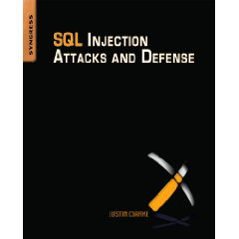
about: us
{Nicholas Arvanitis | Marco Slaviero | Haroon Meer}
Notes:
Nick
SensePost
Boutique Security Services Company operating from South Africa
9th year of operation (8 years of Blackhat/Defcon)
Customers all over the world from Geneva to Gabarone
Training / Papers / Books / Conferences

Slide 3

Why this talk ?
Notes:
MH:
“Cloud” is currently a headline stealer!
But we have been around for a while..
We have the dubious honor of some of the most convoluted/slowest tunneling tools in the world ☺
(my way of saying – we wouldn’t just do this talk for its fashion appeal)
But we do think there is something big going on here..

Slide 4

This is not the time to split hairs

Slide 5
The LOUD in cLOUD security..
A bunch of people are talking about “the cloud”
There are large numbers of people who are immediately down on it:
“There is nothing new here”
“Same old, Same old”
If we stand around splitting hairs, we risk missing something important..

Slide 6

So, what exactly *is* the Cloud?
Notes:
Nick:
Wikipedia - Cloud computing is a style of computing in which dynamically scalable and often virtualized resources are provided as a service over the Internet

Slide 7
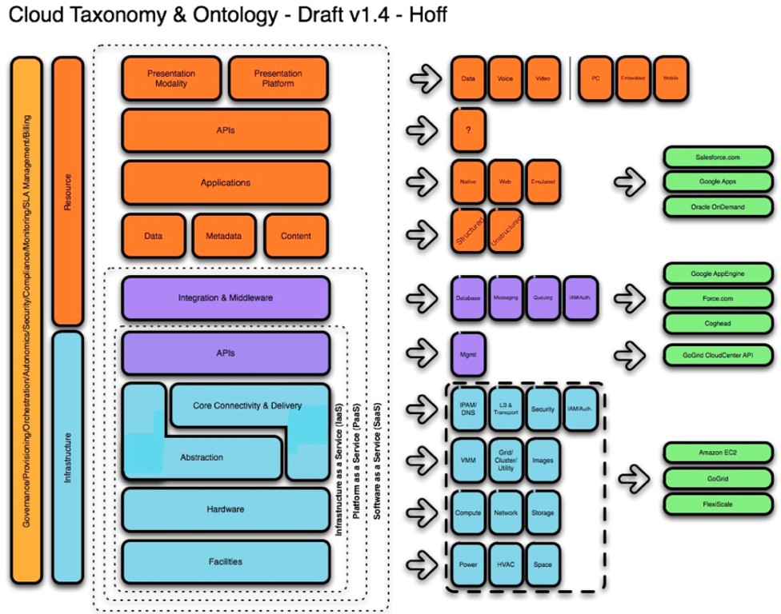
Cloud delivery models
Notes:
Wikipedia - Cloud computing is a style of computing in which dynamically scalable and often virtualized resources are provided as a service over the Internet
Hoff and Cloud Security Alliance have split logically into IaaS, PaaS and SaaS
Architecture Characteristics:
Infrastructure Abstraction
Resource Pooling
Ubiquitous Network Access
On-Demand Self-Service
Elasticity
Jian Zhen VMWare

Slide 8
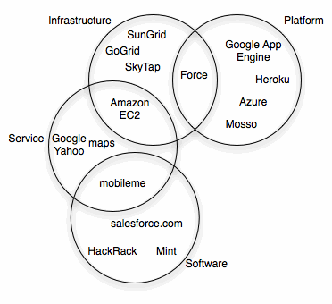
Notes:
We see it simpler.. Stuff we get → stuff we can do..

Slide 9
Why would we want to break it?
It will be where the action is..
Insidious the dark side is..
Amazingly we are making some of the same old mistakes all over again
We really don’t have to..

Slide 10
What is driving Cloud adoption?
Management by in-flight magazine
  Manager Version
  Geek Version
Poor history from IT
Economy is down
  Cost saving becomes more attractive
  Cloud computing allows you to move from CAPEX to OPEX
  (Private Clouds?)
Notes:
We ignoring pvt clouds, because those are internal and not a shared platform with the world for us to attack…
IT bad at delivering on CRM apps – into the cloud, CRM provider

Slide 11
A really attractive option
EC2 is Cool!
Like Crack..

Slide 12

Problems testing the Cloud
Notes:
MH:
The obvious:
Permission?
From whom?
Risk of getting blackballed?
Amazon + my CC + my address.
Who’s data do we walk in on ?
Version changes ?
Transparency..

Slide 13
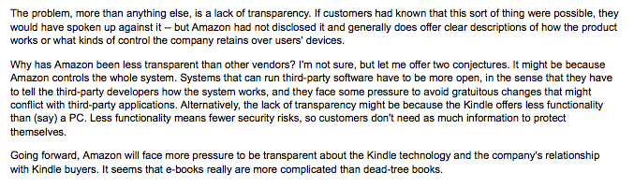





Transparency
Notes:
Nick:
Felten on amazon (kindle) debacle (pulled orwell books). + transparency is key ..
If we talking transparency.. Cloudsec interviewed guido
“sorry we don’t divulge such information”
“I’m not at liberty to discuss details”

Slide 14
Compliance in the Cloud
“If its non-regulated data, go ahead and explore. If it is regulated, hold on. I have not run across anyone comfortable putting sensitive/regulated data in the cloud”
“doesn’t seem to be there as far as comfort level that security and audit aspects of that will stand up to scrutiny” (sic)
--Tim Mather: RSA Security Strategist
Notes:
Privacy and Legal Issues
Compliance in the Cloud ?
Tim Mather: RSA Security Strategist: “If its non-regulated data, go ahead and explore. If it is regulated, hold on. I have not run across anyone comfortable putting sensitive/regulated data in the cloud”
“doesn’t seem to be there as far as comfort level that security and audit aspects of that will stand up to scrutiny” (sic)

Slide 15

Privacy and legal issues
Notes:
Center for democracy and technology
Jim Dempsey (CDT): “Loss of 4th Amendment protection for US companies”
A legal order (court) to serve data, can be used to obtain your data without any notification being served to you.
There is no legal obligation to even inform you it has been given.

Slide 16
Privacy
Jim Dempsey (Center for Democracy and Technology): “Loss of 4th Amendment protection for US companies”
A legal order (court) to serve data, can be used to obtain your data without any notification being served to you
There is no legal obligation to even inform you it has been given
Notes:
Center for democracy and technology

Slide 17

Simple solution..
Crypto Pixie Dust!
Would you trust crypto on an owned box ?
Notes:
MH:

Slide 18
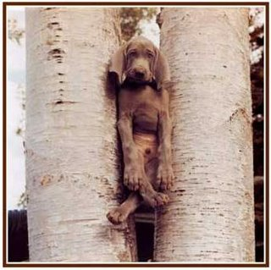
Vendor Lock-in
Pretty self-explanatory
If your relationship dies, how do you get access to your data ?
Is it even your data ?
Notes:
"One reason you should not use web applications to do your computing is that you lose control," he said. "It's just as bad as using a proprietary program. Do your own computing on your own computer with your copy of a freedom-respecting program. If you use a proprietary program or somebody else's web server, you're defenceless. You're putty in the hands of whoever developed that software."

Slide 19
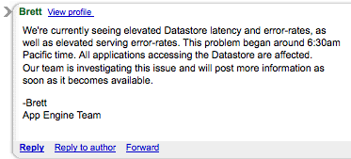
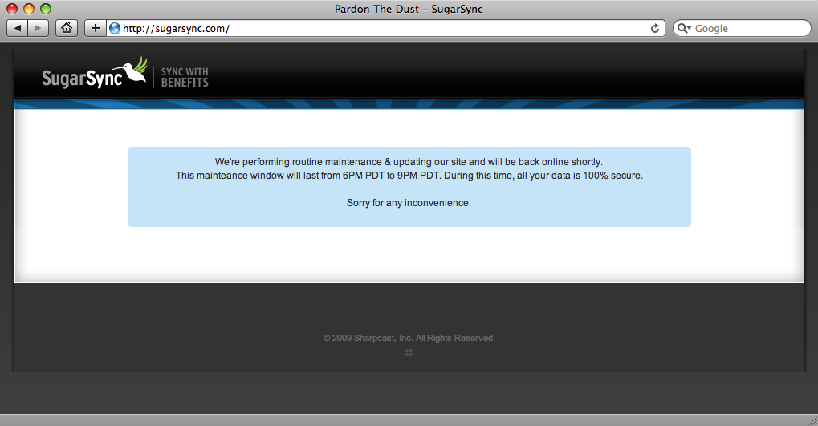
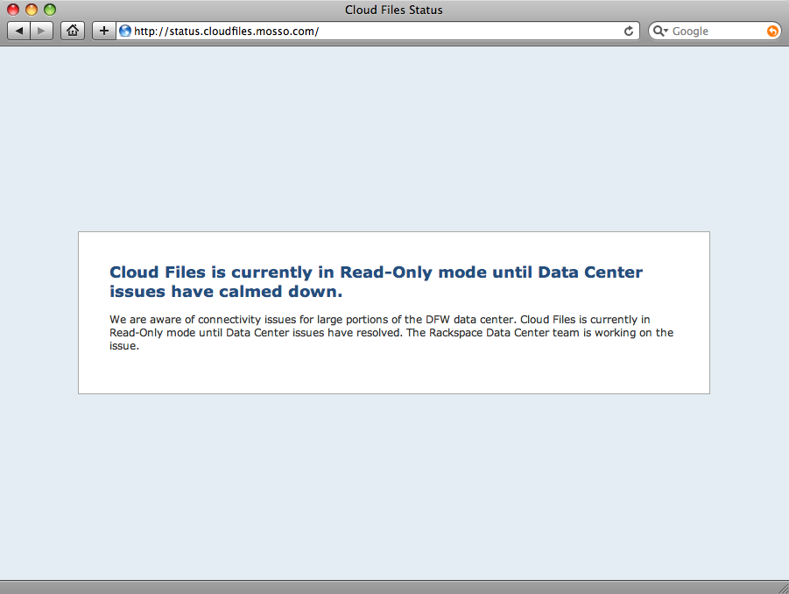
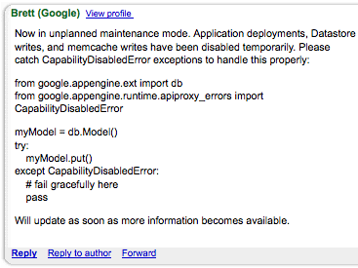
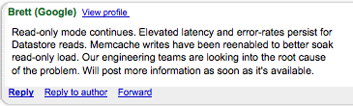
Availability [Big guys fail too?]
Notes:
Nick
Availability is one of the clouds big promises, but everyone fails..
Cloud Files
Sugar Sync
Google App Engine

Slide 20
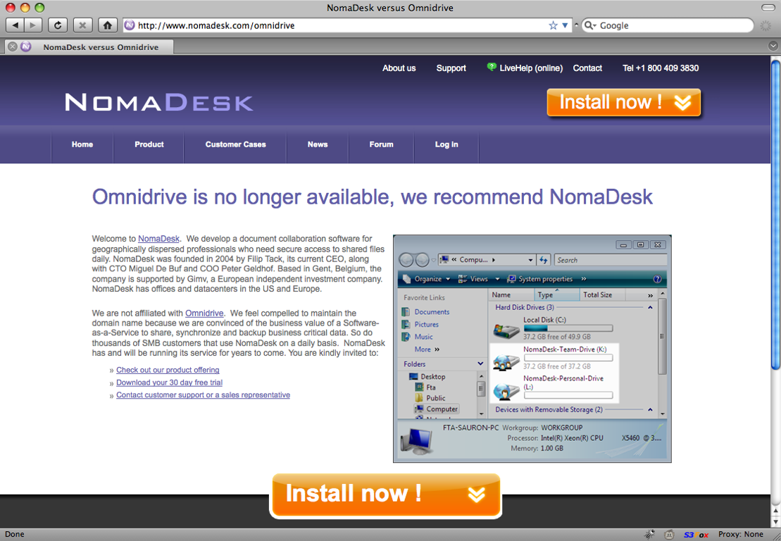
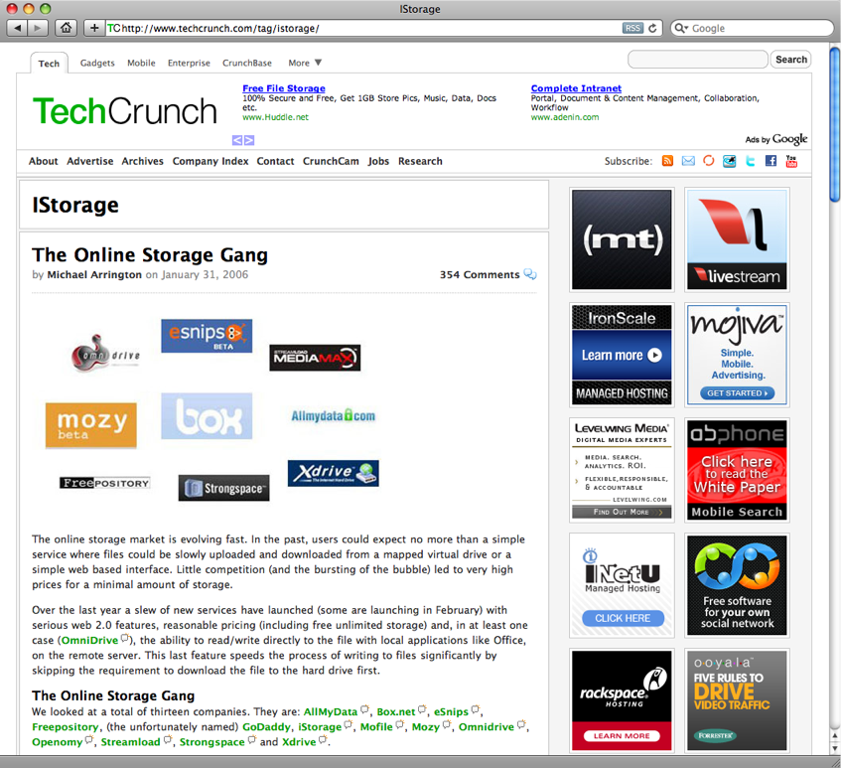
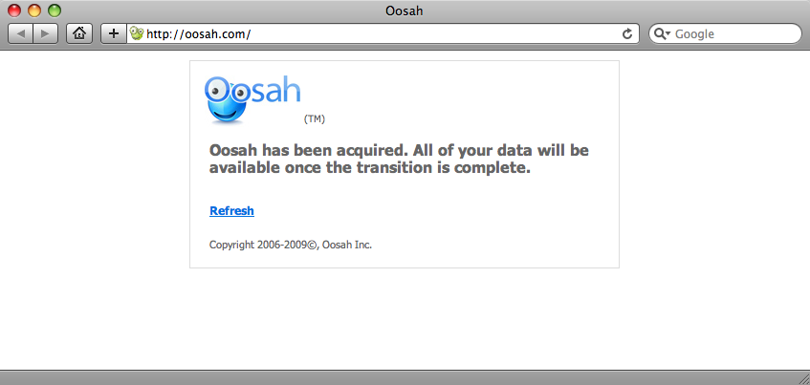
Availability [Not Just Uptime!]
Notes:
MH

Slide 21
Availability [not just uptime!]
Account Lockout?
“Malicious activity from your account”

Slide 22

Monoculture

Slide 23
Monoculture
MonocultureGate is well known in our circles.
Just viewing that pic resulted in a raised average IQ in this room.
His (their) thesis:
  “ A monoculture of networked computers is a convenient and susceptible reservoir of platforms from which to launch attacks; these attacks can and do cascade. ”
Most people agreed with Dr Geer (et al) back then..
Just because its not Windows, doesn’t mean the thesis disappears.

Slide 24

SmugMug Case Study
Process 50+ terapixels per day
Posterchild of AWS
Heavy use of S3 and EC2
Launched 1920 standard instances in one call
You don’t get monoculture’er than ~2000 machines that are all copies of the same image..
ASLR Fail .. ?
Notes:
http://www.slideshare.net/tracylaxdal/aws-startup-event-2009-smugmug
Process: 50+ terapixels per day
Aws startup event 2009

Slide 25

Extending your attack surface
Notes:
Nick:
Beyond your level of control
We already know that our individual organizations can be Phished or bruted (we can discuss the effectiveness of user-education after the talk)
Now you have to worry about your cloud provider getting phished too.
Twitter
Facebook
SF.com
Twitter admin / sf.com admin got pwned…we get taken, we don’t control them…we get pwned
November 2007 - SF.com employee phished – gave up password
Customer details stolen - Spear-phished – some compromises – also targeted malware
Twitterfail – reset password flaw repeated pwnage

Slide 26

While we’re talking about phishing…
Notes:
What does it result in?
Used to be a lost account
Now a lost infrastructure ?

Slide 27
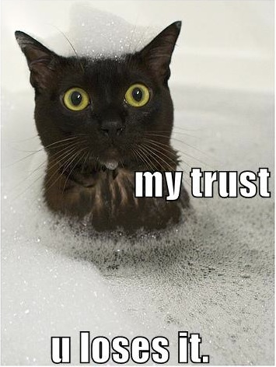
Trust…
Notes:
Why would we trust someone else with our data ?
They have the skills to do it right!

Slide 28
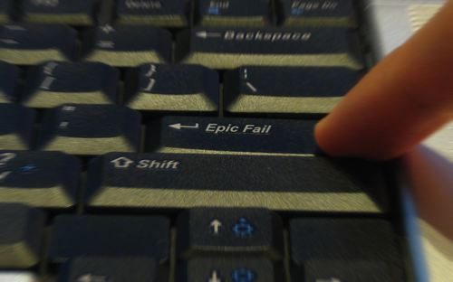
Notes:
Why would we trust someone else with our data ?
They have the skills to do it right!
Examples of admin fails in the cloud.. – nick
Vulns, uptime issues, etc…cloud fails
All your eggs in (someone else’s) basket…CIA
Jan 2009 – SF.com customers all locked out - “core network device failed with memory allocation errors”
Online storage service MediaMax, also called The Linkup, went out of business following a system administration error that deleted active customer data.
Purging data for inactive accounts, to reduce storage – script misidentified active accounts and removed files
Nokia Ovi lost 3 weeks worth of customer data (like MobileMe) –
One of Nokia's Contacts On Ovi servers that manages the chat function failed due to a broken cooler, which resulted in a series of catastrophic events that led to a total crash. The last reliable backup that Nokia could recover was dated Jan. 23, meaning anything synced and stored by users between Jan. 23 and Feb. 9 was lost completely.

Slide 29
Cloud #fail
MediaMax Online Storage – inactive account purging script error whacked active customer accounts
Nokia Ovi (like MobileMe) lost 3 weeks of customer data after crash
Jan 2009 – SF.com customers couldn’t log in – “core network device failed with memory allocation errors”
Notes:
Online storage service MediaMax, also called The Linkup, went out of business following a system administration error that deleted active customer data.
Purging data for inactive accounts, to reduce storage – script misidentified active accounts and removed files
Nokia Ovi lost 3 weeks worth of customer data (like MobileMe) –
One of Nokia's Contacts On Ovi servers that manages the chat function failed due to a broken cooler, which resulted in a series of catastrophic events that led to a total crash. The last reliable backup that Nokia could recover was dated Jan. 23, meaning anything synced and stored by users between Jan. 23 and Feb. 9 was lost completely.
All your eggs in (someone else’s) basket…CIA
Jan 2009 – SF.com customers all locked out - “core network device failed with memory allocation errors”

Slide 30
But you have to trust someone!
<+ben> kostyas cloudbreak stuff really scares me
<+MH> its impressive for sure, but why would that scare you more than simple Amazon evilness ? (Malfeasance)
<+ben> You have to trust someone.. Just like how you trust Microsoft not to backdoor your OS, you trust Amazon not to screw you

Slide 31

Red Herring Alert!

Slide 32
Complete the popular phrase.
Trust, but …………… !
Reverse Engineers keep Microsoft honest
(or at least raise the cost of possibly effective malfeasance)
Even “pre-owned” hardware is relatively easy to spot (for some definition of easy)
But how do we know that Amazon (or other big names) “Wont be evil”™

Slide 33
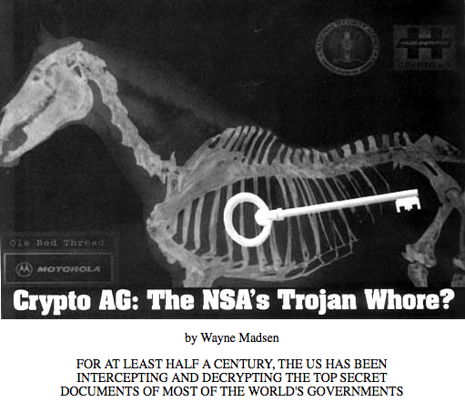
Notes:
Even if some smart people verified that they are not evil today, would we notice if they turned evil tomorrow?
Would we notice if an International Intelligence Agency was sitting in the cloud infrastructure?
Anyone ever heard of CryptoAG ?
Google swiss ag + nsa -> hit2 -> http://mediafilter.org/caq/cryptogate/ == “cryptoAG: the nsa’s trojan whore”
For half a century, Crypto AG, a Swiss company located in Zug, has sold to more than 100 countries the encryption machines their officials rely upon to exchange their most sensitive economic, diplomatic and military messages. Crypto AG was founded in 1952 by the legendary (Russian born) Swedish cryptographer Boris Hagelin. During World War II, Hagelin sold 140,000 of his machine to the US Army.
"In the meantime, the Crypto AG has built up long standing cooperative relations with customers in 130 countries," states a prospectus of the company. The home page of the company Web site says, "Crypto AG is the preferred top-security partner for civilian and military authorities worldwide. Security is our business and will always remain our business."
And for all those years, US eavesdroppers could read these messages without the least difficulty. A decade after the end of WWII, the NSA, also known as No Such Agency, had rigged the Crypto AG machines in various ways according to the targeted countries. It is probably no exaggeration to state that this 20th century version of the "Trojan horse" is quite likely the greatest sting in modern history.

Slide 34

Web Application Security
Notes:
Nick
Cloud tied to Web tied to.. -Nobody still makes the same old web application mistakes do they…?
Statistics on tested Applications are shocking from almost every source.
Twitter - Multiple XSS worms, access to admin backend through compromise of Twitter employee’s password – that’s *all* they do?!
Samy XSS worm – 2005 - Led to a plethora of talk and research on web application worms…
XSRF in Gmail – January 2007 – Contact list hijacking – mail stealing PDP / jeremiah - XSS flaws in Google SSL page – May 2009 - XSRF + XSS…ouch

Slide 35
Using the Cloud..
  For hax0r fun and profit:
  Dino Dai Zovi vs. Debian
  Ben Nagy vs. MS Office
  Dmolnar && Zynamics
Notes:
Other guys have been quick to spot the benefits provided by computation on tap..

Slide 36


Notes:
Recall the debian openssl debacle/disaster..
1. Populate a distributed queue with strings describing which keys to generate
2. Launch 20 VMs (the default limit)
3. Fetch key descriptors from queue, generate batches of keys, and store in S3
Generating 524,288 RSA keys
262,144 RSA keys on 20 32-bit instances ▪$0.10 x 20 machines x 4 hours = $8
262,144 RSA keys on 20 64-bit instances ▪$0.20 x 20 machines x 2 hours = $8
Decrypting your SSL traffic: Priceless

Slide 37
DDZ vs Debian
  1. Populate a distributed queue with strings describing which keys to generate
  2. Launch 20 VMs (the default limit)
  3. Fetch key descriptors from queue, generate batches of keys, and store in S3
  524,288 RSA keys – 6 Hours - $16

Slide 38
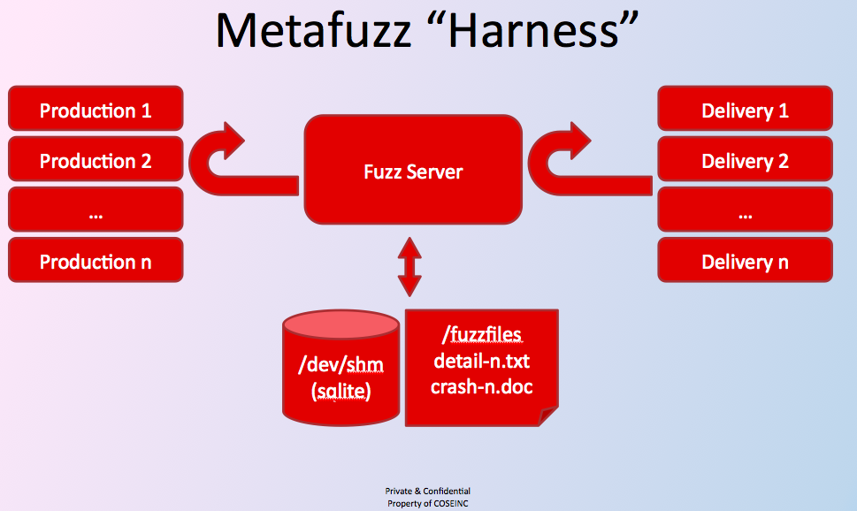
Notes:
Ban nagy recently spoke at syscan on his metafuzz office fuzzing suite.
Effectively ben paralellized his scanning by using multiple machines to run his fuzz harness..
Went from performing n tests per minute to m tests per minute..

Slide 39
Zynamics && DMolnar
Zynamics use EC2 to demo software and classify malware, upto ~50k samples/day
David Molnar and friends fuzztest Linux binaries, sift results and notify devs, all on EC2
Notes:
Zynamics use EC2 to demo software to customers as well as to farm out processing of malware classification aiming for 30k-50k samples per day.
Dmolnar -

Slide 40

























Some of the players
Notes:
http://www.johnmwillis.com/cloud-computing/cloud-vendors-a-to-z-revised/

Slide 41
The ones we looked at…
Notes:
Lots of coolness in these systems
Lots to learn and lots to explain
We cover the necessary parts of the architecture as they come up

Slide 42
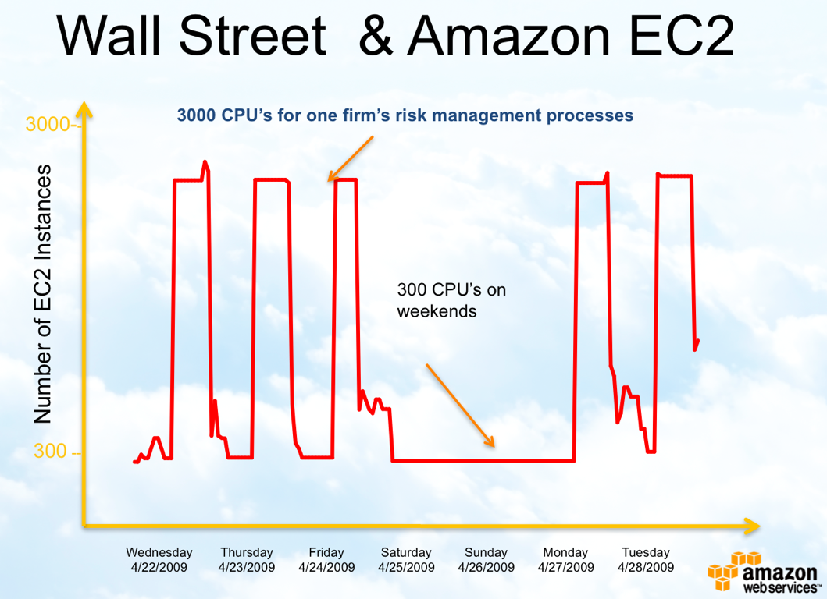
Autoscaling / Usage costing
Autoscaling is a great idea for companies.
Notes:
MH:

Slide 43

Can you spot the
danger?
Notes:
We blogged about this waaaaaay back
A 10 line twill / wget script is going to be able to drive up utilization -> which can drive up costs
This doesn’t mean it’s a bad idea. This sort of dos always existed
But it’s a new thing for us to look for when auditing.. i.e. if ur customers app can be trivially tricked into doing a lot of work, then it can be expensive..
This is well understood in crypto circles -

Slide 44
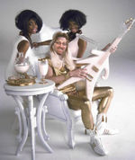
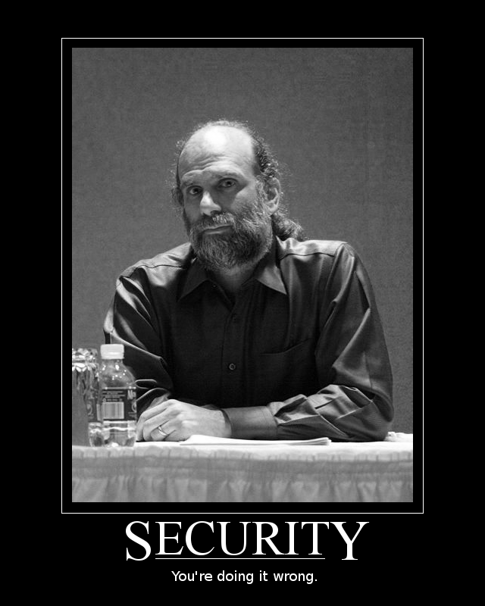



Notes:
Talk has been increasing on incentivisation in security
The question is “who is incentivised here to fix this?”
It sounds a lot like the problem adwords face with clickfraud, except that in a way, click fraud self regulates.
There is no such feedback loop here..
http://rationalsecurity.typepad.com/blog/2009/01/a-couple-of-followups-on-my-edos-economic-denial-of-sustainability-concept.html
“Amazon announced the beta of Amazon SimpleDB without that much fanfare, but it is an interesting trend to watch..
Essentially amazon are giving the power of a database to people used to excel and simple queries, backed by their massively optimised infrastructure. It will make popping up a web shop even more trivial than it has been in the past, and i guess continues along the growing trend of allowing "content to be king". i.e. u dont need a sql geek in your corner, just a good idea .
Now this will obviously work only for simple queries in the short term, but it is a big score for a pay per use hosted db service. It obviously raises privacy questions but this is a trade off im sure many will happily make..
(it also raises the interesting question of sabotaging someone, by simply running multiple queries on his site.. i.e. since the site owner is paying amazon based on db usage, a simple wget script that fetches the price of an item recursively could end up costing the site owner a small fortune! Now this is a similar problem to the one google had with ad-words, but ad-words self regulate based on pricing.. i.e. if i have an ad and am willing to pay $1 per impression today i am happy because i have calculated that i get an x% conversion. Some monkey wgets my add 9999999999999 times effectively uppign my cost of the advert.. but.. this also affects my value.. because my conversion rate just went down.. so i will be willing to pay less for the ad.. the db usage cost (from the little ive seen) is fixed.. which means it costs me, but never amazon.. (in an extreme, it would pay amazon to hire ppl to surf apps that are hosted through simple DB) ;>)
Thats just me the pessimist speaking.. for now.. its cool, and bears watching!”
(Economic Denial of Sustainability)

Slide 45
Storage as a Service
In most cases this is a really simple model
Faster Internet tubes is making backing up over tubes reasonable
Disk access anywhere is a nice idea
All throw crypto-pixieDust-magic words in their marketing documents
For good measure all throw in Web based GUI access
Notes:
Nick:
Storage as a service is really popular
Lots of ppl actually using skins on top of bigger providers offerings (like amazon s3)

Slide 46

Web Apps
+
File Systems
Notes:
What could go wrong ?
WebApps + FileSystems
We have been upscrewing that for years..
Whats cool is that its like 1994 + nfs shares all over again

Slide 47

Amazon EC2 Secure Wiping
Notes:
Amazon + secure Wiping - Recover stuff from disks with undelete etc
2006 - Amazon didn’t wipe disks in EC2 – host was shut down, drives were just partitioned, formatted and new OS re-installed
Source code, keys etc
Strings + file system analysis tools

Slide 48

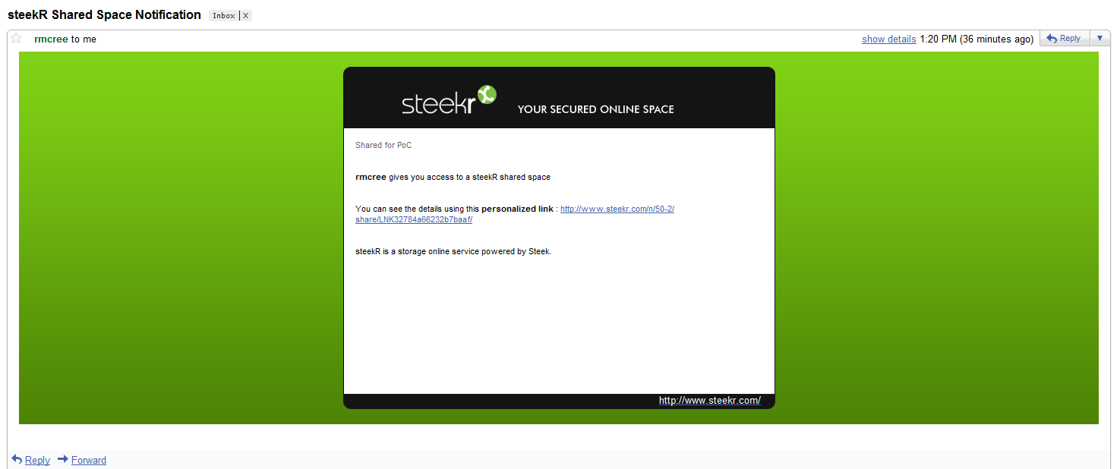

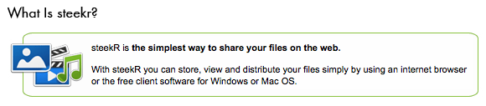
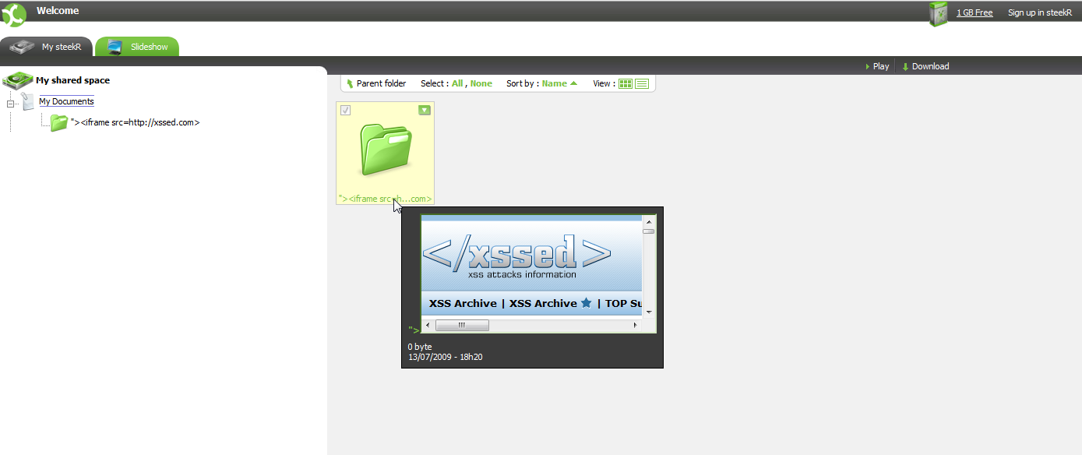
Notes:
Holisticinfosec.org → Russ Mcree
Really lame brokenness – XSS in filename
“They further suffer from a complete inability to respond to responsible disclosures (multiple attempts over two weeks).
Thus, I struggle with their “Your Secured Online Space” claim. As in…not so much.”
Explain the danger briefly

Slide 49
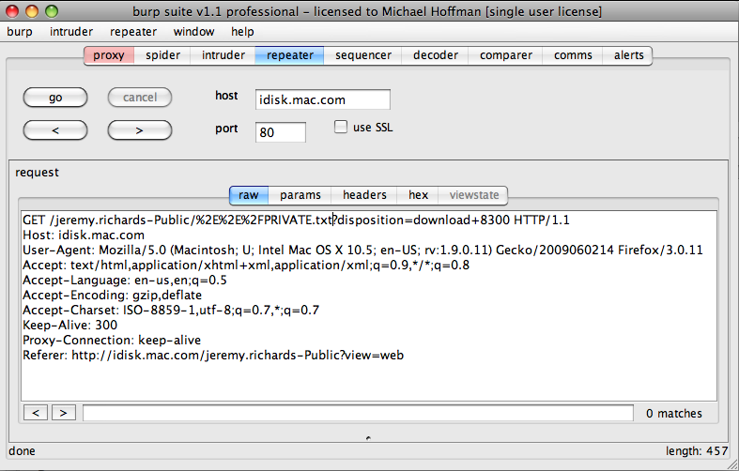
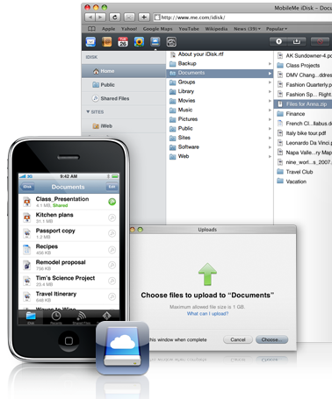

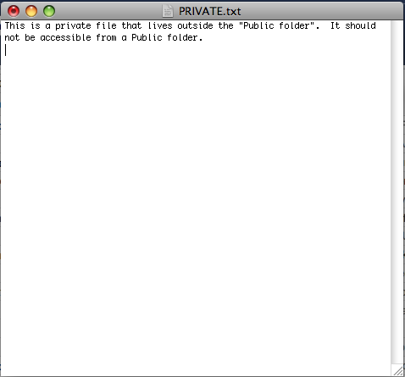
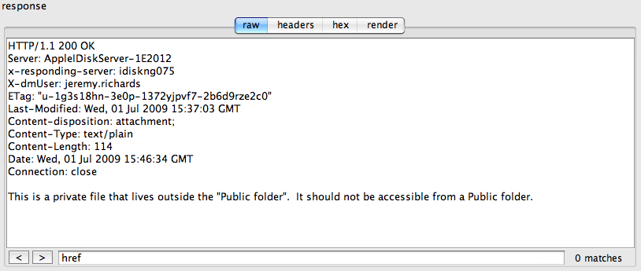
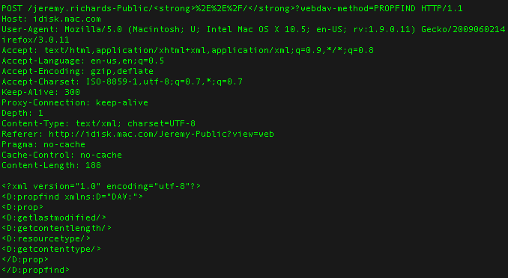
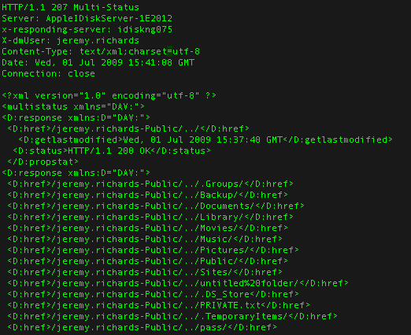

Slide 50
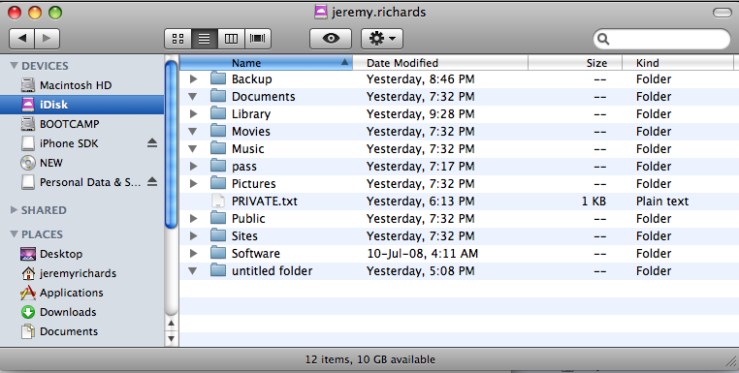

Slide 54
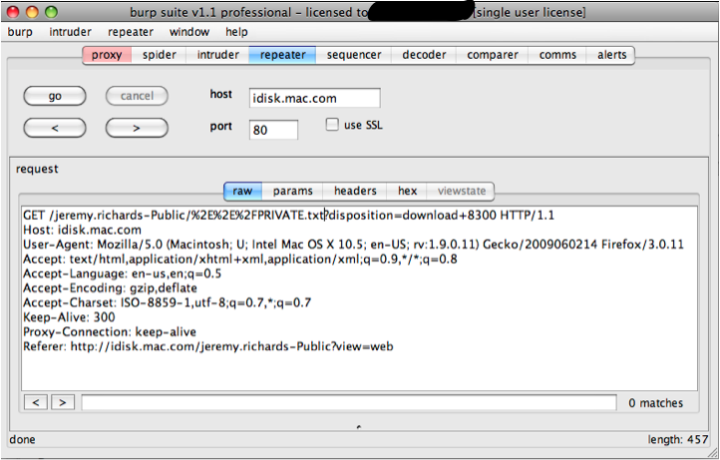

Slide 56
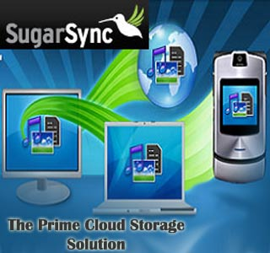
Notes:
We decided to take a look at sugarsync, and signed up some demo accounts..

Slide 57

Notes:
One of the first things I wanted to do, was port crowbar to the cloud.
Crowbar is our intelligent bruteforcer

Slide 58



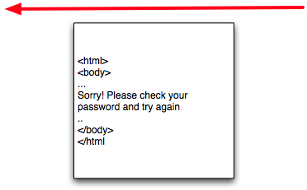
Notes:
Why crowbar? Good name, bad pass → return page with error

Slide 59

Notes:
Why crowbar? Good name, bad pass → return page with error

Slide 60

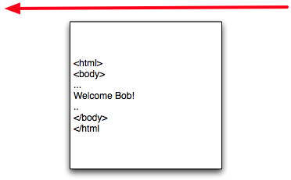
Notes:
How do we do this consistently? What if the app doesn’t say “welcome”
Crowbar..

Slide 61

Notes:
How do we do this consistently? What if the app doesn’t say “welcome”
Crowbar..

Slide 62
Notes:
So crowbar is useful, and cute..

Slide 63

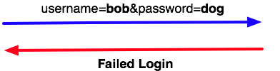
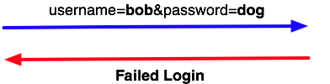
Notes:
But bruteforce is an old problem and is solved by lockout ?
We could brute usernames

Slide 64





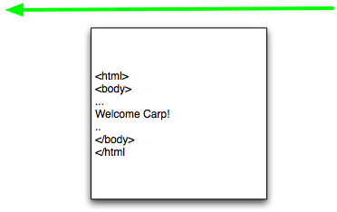
Notes:
Lets go back to a good login

Slide 65
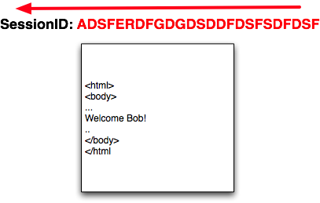


Notes:
Spot the session..

Slide 66
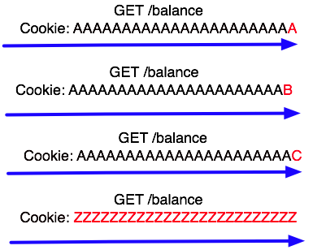


Slide 67
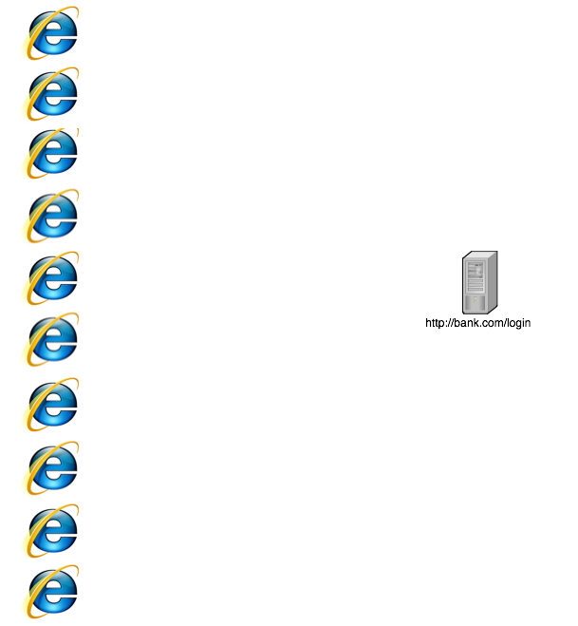
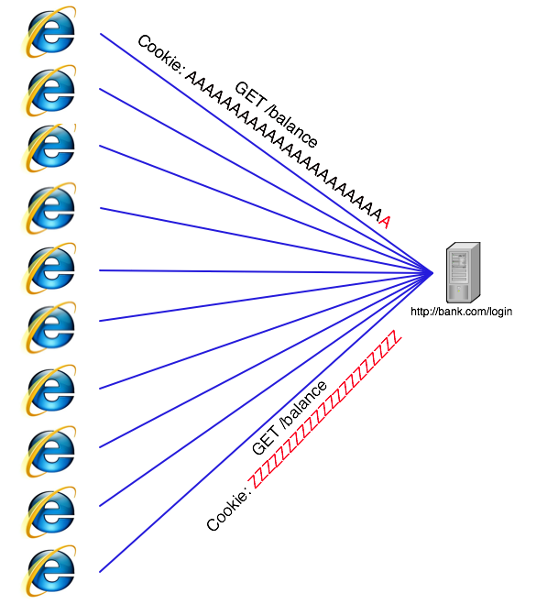
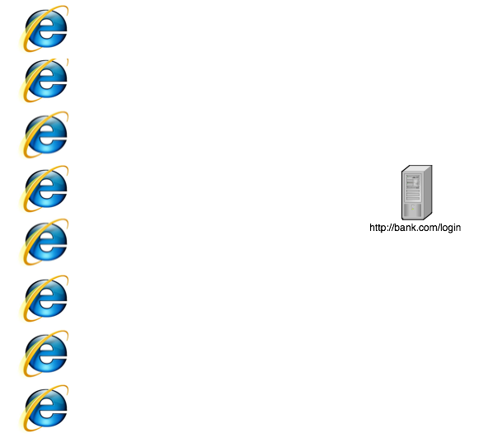
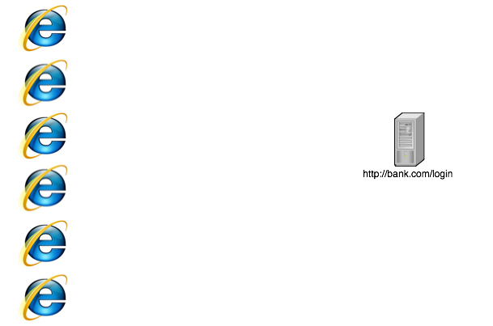
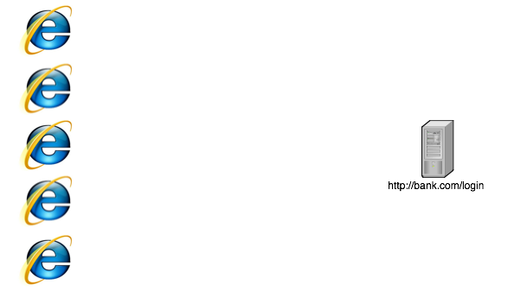
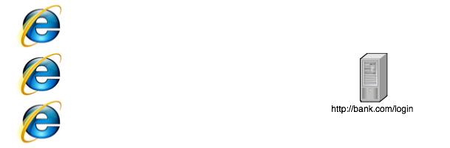

Notes:
This is built, and we will release it
The obvious downside is u risk dossing the target
Its also more expensive than a botnet.
But.. Very attractive when u consider looooong sessions
Also cool for aws to aws! (free!)

Slide 68
Notes:
We decided to take a look at sugarsync, and signed up some demo accounts..

Slide 69
file:///Users/haroon/Desktop/Vegas_Video/sugarsync/sugarsync-proj/sugarsync-proj.html
Overview of sugarsync + normal password reset
Ends with sample link..

Slide 70
Its Short, Brute & Declare Victory
?secret = for472gtb422
= lower case alphanumeric
= 35^12
= Still a too big number ☹
Birthday Attack ?
= 1.2 * sqrt(35^12)
= Still a pretty big number
Notes:
2 205 918 750

Slide 71
https://www.sugarsync.com/reset-password?secret=6076kgbni87b
https://www.sugarsync.com/reset-password?secret=bt45nq32gvzc9
https://www.sugarsync.com/reset-password?secret=fk0c79goxbzwb
https://www.sugarsync.com/reset-password?secret=bzx5gor7yaj45
https://www.sugarsync.com/reset-password?secret=b9xhfaitwok6a
https://www.sugarsync.com/reset-password?secret=evifc5cvd79aw
https://www.sugarsync.com/reset-password?secret=d7q7mba80hpqs
https://www.sugarsync.com/reset-password?secret=ds3a27qdpyoym
https://www.sugarsync.com/reset-password?secret=bms9kxwp2ypeq
https://www.sugarsync.com/reset-password?secret=xi3pzry9s7kz
https://www.sugarsync.com/reset-password?secret=cs3pd8tyenedp
https://www.sugarsync.com/reset-password?secret=dmmzgfgvyqw72
https://www.sugarsync.com/reset-password?secret=cw8jqev4yvv0w
https://www.sugarsync.com/reset-password?secret=edp9iog7fj60r
https://www.sugarsync.com/reset-password?secret=cxom0z2a62iva
https://www.sugarsync.com/reset-password?secret=bv45tsonz8tdi
https://www.sugarsync.com/reset-password?secret=cv7z95jyctnd5
https://www.sugarsync.com/reset-password?secret=cq2j8wdbbo7om
https://www.sugarsync.com/reset-password?secret=bmtjn6j3hteky
https://www.sugarsync.com/reset-password?secret=fjrofysj887bf
https://www.sugarsync.com/reset-password?secret=de4acew6hsn4s
https://www.sugarsync.com/reset-password?secret=fdie4jk2jy56c
https://www.sugarsync.com/reset-password?secret=d20rt64rbywtd
https://www.sugarsync.com/reset-password?secret=drdprygkij2rg
https://www.sugarsync.com/reset-password?secret=brnazhekohvrw
https://www.sugarsync.com/reset-password?secret=ekivezkzgy9oo
https://www.sugarsync.com/reset-password?secret=dynnmny3xrcxz
https://www.sugarsync.com/reset-password?secret=bwvj29v4ty765
https://www.sugarsync.com/reset-password?secret=d2tkoah29zq5p
https://www.sugarsync.com/reset-password?secret=fjmhfxr0q8ivk
https://www.sugarsync.com/reset-password?secret=kk4e7rs55f60
https://www.sugarsync.com/reset-password?secret=bzxejaxd35687
https://www.sugarsync.com/reset-password?secret=fc274gqrq03rk
https://www.sugarsync.com/reset-password?secret=die4od59cy93d
https://www.sugarsync.com/reset-password?secret=epdp3vckqexaj
https://www.sugarsync.com/reset-password?secret=zf3fyt7vk9j
https://www.sugarsync.com/reset-password?secret=eyir7wd6vfca6
https://www.sugarsync.com/reset-password?secret=r7zp8ppjpztc
https://www.sugarsync.com/reset-password?secret=dadq3z0zgknqe
https://www.sugarsync.com/reset-password?secret=c3hfqavknett0
https://www.sugarsync.com/reset-password?secret=3pv2ojtc5t40
https://www.sugarsync.com/reset-password?secret=d4beabdor72tx
https://www.sugarsync.com/reset-password?secret=cq7q5a9imttjp
https://www.sugarsync.com/reset-password?secret=dk0tot820d7vs
https://www.sugarsync.com/reset-password?secret=b6bip7pswf9m2
https://www.sugarsync.com/reset-password?secret=bx424nj2p2y9e
https://www.sugarsync.com/reset-password?secret=bz6to064jf3qp
https://www.sugarsync.com/reset-password?secret=ebgbgprc6eq2f
https://www.sugarsync.com/reset-password?secret=modziars6o2d
https://www.sugarsync.com/reset-password?secret=wi3vkonsia3
https://www.sugarsync.com/reset-password?secret=cmbicqc34apjf
https://www.sugarsync.com/reset-password?secret=e2fqw2kogy8gc
https://www.sugarsync.com/reset-password?secret=fkno8o8ws7th
https://www.sugarsync.com/reset-password?secret=8g8jfig0m8hk
https://www.sugarsync.com/reset-password?secret=ea760dof3zpve
https://www.sugarsync.com/reset-password?secret=dr8rsap8ieinv
https://www.sugarsync.com/reset-password?secret=d3hmdc3srnyng
https://www.sugarsync.com/reset-password?secret=dcnckpph35vko
https://www.sugarsync.com/reset-password?secret=ejr0k3ro4nepm
https://www.sugarsync.com/reset-password?secret=etcasjbo2sa9k
https://www.sugarsync.com/reset-password?secret=e0ijravm5awrf
https://www.sugarsync.com/reset-password?secret=bbjb3rabpngha
https://www.sugarsync.com/reset-password?secret=di8qwc355270y
https://www.sugarsync.com/reset-password?secret=cm5esewps28y2
https://www.sugarsync.com/reset-password?secret=mofph975924
https://www.sugarsync.com/reset-password?secret=b5eptnaefja5f
https://www.sugarsync.com/reset-password?secret=dqshjvg8pyyxn
https://www.sugarsync.com/reset-password?secret=byjd3bwq39rgi
https://www.sugarsync.com/reset-password?secret=di4wgdecj2ci0
https://www.sugarsync.com/reset-password?secret=ebiyxam7cextk
https://www.sugarsync.com/reset-password?secret=emxscrt769hi
https://www.sugarsync.com/reset-password?secret=ein2b5gwj4vpx
https://www.sugarsync.com/reset-password?secret=c485kmqj7jcvo
https://www.sugarsync.com/reset-password?secret=x83hrq5zgkfc
https://www.sugarsync.com/reset-password?secret=ejrdyyr02pxcz
https://www.sugarsync.com/reset-password?secret=dnacznkenc57z
https://www.sugarsync.com/reset-password?secret=emmiagm6b55ig
https://www.sugarsync.com/reset-password?secret=ca3xztf6pj44i
https://www.sugarsync.com/reset-password?secret=dqmejm2dfq8jb
https://www.sugarsync.com/reset-password?secret=c9879b9oqzbzj
https://www.sugarsync.com/reset-password?secret=d9vc00wo09mc0
https://www.sugarsync.com/reset-password?secret=e9ghwgdt5eze6
https://www.sugarsync.com/reset-password?secret=cgk799cwjgmaa
https://www.sugarsync.com/reset-password?secret=6pz2nk4sdr20
https://www.sugarsync.com/reset-password?secret=fbwgaiqs7o2wp
https://www.sugarsync.com/reset-password?secret=eaffpy57jyf78
Notes:
So instead of admiting I failed, I hoped to get lucky.. I hoped I cld figure how they gen the reset string
If I cld get some insight there, I wld still win (and ignore the fact that I built crow-cloud flor nothing.

Slide 72
We Have 2 Days..
single thread : 1 hour : 648
: 2 days : 31104
10 threads : : 221472
10 machines : : 2 214 720
Wont they notice ?
Notes:
Not in the 48 hours we ran our scripts for
Its EC2 to EC2, so we also get to test free..

Slide 73


Slide 74
Saved (some pride)
[sugarsync vids]
Notes:
Not hype – not a new attack and nominated for a pwnie :>
Even in cursory testing, can see how some things could go wrong

Slide 75

PaaS
Notes:
Nick

Slide 76
Actually..
SF.com is both SaaS and PaaS
We took a quick look at SaaS
Good filtering, and held up well to cursory testing
Why cursory?
Ultimately, it *is* a web application..
Notes:
Both SaaS and PaaS
We took a quick look at SaaS
Good Filtering, and held up well to cursory testing
Why cursory?
Ultimately, it is a web application..

Slide 77
Clickjack
[clickjack vid]
Notes:
Not hype – not a new attack and nominated for a pwnie :>
Even in cursory testing, can see how some things could go wrong

Slide 78

SalesForce back story
10 years old
Initially web-based CRM software
  59 000 customers
  $1 billion in revenue
Distributed infrastructure was created to support CRM (SaaS, weeeee!)
Platform was exposed to architects and devs, for PaaS and IaaS
  (Ambitious project with solid aims)
Notes:
Slav:

Slide 79
Salesforce business model
Multi-tenant
  Customers share infrastructure
  Spread out across the world
Subscription model
  Scales with features and per-license cost
Free dev accounts
  More limited than paid-for orgs
AppExchange
  Third party apps (ala App Store)

Slide 80
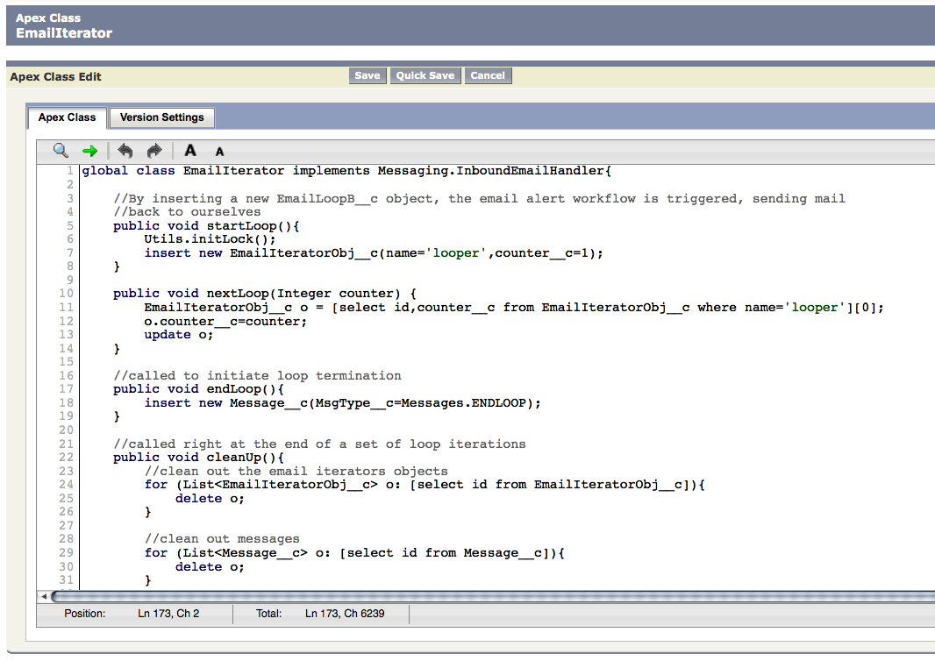
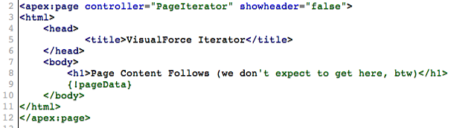
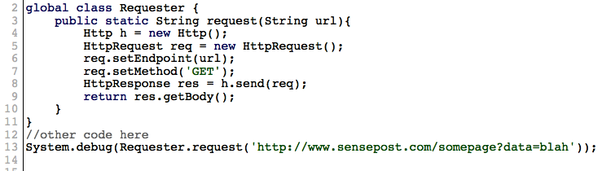
Developing on Salesforce
Primary components
HTML pages written in custom VisualForce language
Business logic written in Java-like Apex
Datastore
  SOQL
  SOSL
Dev environment typically written in browser or in Eclipse with plugin
Notes:
VisualForce – templating language, closely tied to data objects
Apex – Custom Java-like language with specific focus on rapid data-driven development. Turing-complete
Datastore – SOQL Supports custom limited SQL-like queries (select, insert, update, delete) on single objects (or table-like structures)
SOSL supports queries across more than one object

Slide 81
Other language features
Make HTTP requests
Bind classes to WS endpoints
Can send mails
Bind classes to mail endpoints
Configure triggers on datastore activities
Notes:
Fairly low-level HTTP interface available, allowing everything from regular HTML over HTTP to SOAP/HTTP

Slide 82
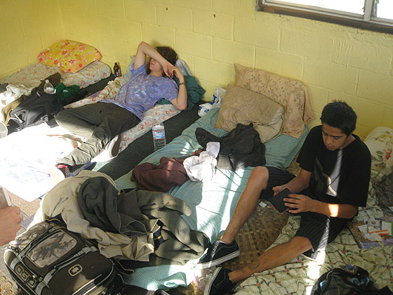
…an obvious problem for resource sharing
Multi-tenancy…

Slide 83

The Governor
Each script execution is subject to strict limits
Uncatchable exception issued when limits exceeded
Limits based on entry point of code
Limits applied to namespaces
  Org gets limits
  Certified apps get limits
Published Limits
Number of scripts lines
Number of queries
Size of returned datasets
Number of callouts
Number of sent emails
…
Unpublished Limits
Number of received mails
Running time
???

Slide 84
Apex limitations
Language focused on short bursts of execution
Can’t easily alter SF configuration
  Requires web interface interactions
APIs short on parallel programming primitives
  no explicit locks and very broad synchronisation
  no real threads
  no ability to pause execution
  no explicit shared mem
API call order important
Notes:
Not designed for continuous execution

Slide 85
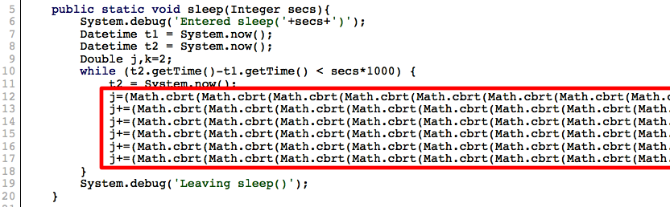

Workarounds
Delays
Synchronisation
Shared mem
Triggers
Threads?

Slide 86


Bypassing the governor
Wanted more usage than permitted for a single user action
Focused on creating event loops
  Initial attempts focused on the callout feature and web services and then VisualForce pages (no dice)
  Wanted to steer clear of third party interference
  Settled on email
Gave us many rounds (+-1500 a day) of execution with a single user action
The job executed is up to user’s imagination
Notes:
Attack was oblique, did not break the governor but circumvented it

Slide 87

And so?
Notes:
With an event loop, web access, locking, shared mem and delays, we looked around for a suitable example

Slide 88
Sifto!
Ported Nikto into the cloud as a simple e.g.
Process
  Class adds allowed endpoint through HTTP calls to SF web interface
  Event loop kicked off against target
    Each iteration performs ten tests
    State simply inserted into datastore at end of ten tests
    Trigger object inserted to fire off email for next iteration
    Results returned via email as they are found
Why?
  Free!
  Fast (for .za)
  Anonymity

Slide 89
[sifto vid]

Slide 90
Pros / cons
Pros
  Fast(er) with more bandwidth
  Free!
  Capacity for DoS outweighs home user
  How about SF DoS?
Cons
  Prone to monitoring
  Custom language / platform
  Technique governed by email limits

Slide 91


Sharding
Accounts have limits
Accounts are 0-cost
Accounts can communicate
How about chaining accounts?
  Sounds good, need to auto-register
CAPTCHA protects reg
  Not a big issue
Cool, now in posession of 200+ accounts!
(Also can locate either in AP or US)
Clusters shared by paid-for and trial accounts… interesting…

Slide 92
Future Directions
Sifto is a *really* basic POC hinting at possibilities
  Turing complete, open field. Limited API though
Platform is developing rapidly, future changes in this area will introduce new possibilities
  Callouts in triggers for event loops
  Reduction in limitations
  Improvements in language and APIs
Abstracted functionality on *aaS makes usage easier, but impact remains
Security is transferred into hands of non-security aware C-levels, ouch.
Rootkits
Security community interaction

Slide 93

Notes:
MH:

Slide 94

Yes…it’s that cool…
Notes:
It’s the coolest thing ive played with in a while..

Slide 95
The Pieces (that we will touch)..
  EC2
  S3
  SQS
  DevPay
What we ignore:
  SimpleDB
  Elastic IP
  CloudFront
  Elastic MapReduce
  Mechanical Turk
Notes:
We ignore simpledb, Elastic ips, ebs, cloudfront, elastic map reduce, mechanical turk

Slide 96

EC2
Root access to a Linux machine in seconds..
Scalable costs..
Notes:
* Create an Amazon Machine Image (AMI) containing your applications, libraries, data and associated configuration settings. Or use pre-configured, templated images to get up and running immediately.
* Upload the AMI into Amazon S3. Amazon EC2 provides tools that make storing the AMI simple. Amazon S3 provides a safe, reliable and fast repository to store your images.
* Use Amazon EC2 web service to configure security and network access.
* Choose which instance type(s) and operating system you want, then start, terminate, and monitor as many instances of your AMI as needed, using the web service APIs or the variety of management tools provided.
* Determine whether you want to run in multiple locations, utilize static IP endpoints, or attach persistent block storage to your instances.
* Pay only for the resources that you actually consume, like instance-hours or data transfer.

Slide 97

S3
Simple storage service
Aws description of S3 – stored in buckets using unique keys
Scalable data storage in-the-cloud
Highly available and durable
Pay-as-you-go pricing
Notes:
Simple storage service
Aws description of S3 – stored in buckets using unique keys
Scalable data storage in-the-cloud
Highly available and durable
Pay-as-you-go pricing
Service Level Agreement: 99.9%

Slide 98
14 Billion
10 Billion
5 Billion
800 Million
August 06
April 07
October 07
January 08

Slide 99
Amazon S3
Amazon S3
mculver-images
media.mydomain.com
bucket
bucket
Beach.jpg
2005/party/hat.jpg
img1.jpg
img2.jpg
object
object
object
object
public.blueorigin.com
bucket
index.html
img/pic1.jpg
object
object

Slide 100
SQS
Consumer
Producer
Queue
Producer
Consumer
Producer
Notes:
Simple queue service..
Reliable, highly scalable, hosted queue for messaging
Build automated workflows for all applications
Coordinate multiple Amazon EC2 instances

Slide 101
When in doubt..
Copy Marco!
Can we steal computing resources from Amazon (or Amazon users?)
Sure we can..

Slide 102

Breakdown
Amazon provide 47 machine images that they built themselves..
Notes:
2721 images built by other people
Think they were all built securely ?

Slide 103
Shared AMI gifts FTW!
Bundled AMI’s + Forum Posts
Vulnerable servers? Set_slice? SSHD?
Scanning gets you booted.. We needed an alternative..
Notes:
Ec2 + bundled amis + with keys + forum posts
Forums are full of people who have created machines but forgot their creds on it
Vulnerable servers? Set_slice vulnerability / sshd ?
Who is responsible? Obviously the owner.. But does amz have a cross to bear here?
Scanning could get u booted, so the stuff u got used to with ur own infrastructure /qualys/hackrack isnt allowed anymore..
Its like we were losing a fight, got to this point, and then decided we will tie one arm behind our back going forward..

Slide 104








GhettoScan

Slide 105


Results
s3 haroon$ grep High *.nsr |wc -l
1293
s3 haroon$ grep Critical *.nsr |wc -l
646
Notes:
.bash_history
.mysql_history
Peoples code..
Peoples pictures.

Slide 106

License Stealing

Slide 107






Slide 108


Why stop there?
Notes:
Devpay overview
Neek steel

Slide 109
AWS
[neek steal vid]
Notes:
Not hype – not a new attack and nominated for a pwnie :>
Even in cursory testing, can see how some things could go wrong

Slide 110
AWS as a single point of failure
Availability is a huge selling point
Some DoS attacks cant be stopped.. It’s simply using the service..
But it does need to be considered..

Slide 111

But it is Amazon!!

Slide 112

DDoS ? Really?
Notes:
This is 2009 – ddos is an old problem..
How about app dos’es ?
Restrict new accounts to 20 machine boots

Slide 113
and
file:///Users/haroon/Desktop/Vegas_Video/ec2-multilogin/ec2-create-20-release/ec2-create-20-proj/ec2-create-20-proj.html

Slide 114
Twill Loving!
[ec2 account creation vid]
Notes:
No captcha on account creation
No check for dup credentials
What does this mean ?

Slide 115


Scaling Registration?
3 minutes

Slide 116
3 minutes
6 minutes

Slide 117
3 minutes
6 minutes
9 minutes

Slide 118

Slav graph -> 4 hours ? N machines ?

Slide 119


Another way to steal machine time
Notes:
Said before that amazon only created about 50 machines..
The rest have been created by joe bloggs.. (web 2.0 + user created images?)
Do people really just run machines other ppl create?
Trusting other images

Slide 120

Really ?
Notes:
Get someone to boot our image?

Slide 121
Can we get people to run our image?
Bundle an image
Register the image (Amazon assigns it an AMI-ID)
Wait for someone to run it
Profit!
Alas..

Slide 122


Can we get people to run our image?
Bundle an image
Notes:
Register the image (Amazon assigns it an AMI-ID)
Wait for someone to run it
Profit!
Alas..

Slide 123
Can we get people to run our image?
Bundle an image
Register the image (Amazon assigns it an AMI-ID)
Wait for someone to run it
Profit!
Alas..
Notes:
Register the image (Amazon assigns it an AMI-ID)
Wait for someone to run it
Profit!
Alas..

Slide 124
Register image, too high, race, top5
file:///Users/haroon/Desktop/Vegas_Video/aws-race/aws-race-release/aws-race-proj.html

Slide 125
AMI creation
[registration racing vid]

Slide 126

Notes:
Recall that s3 namespace stuff ?

Slide 127
S3 + Image names are going to set off another name grab!
Register image as Fedora ?
[root@ec2box] # ec2-upload-bundle –b Fedora –m /tmp/image.manifest.xml –a secret –s secret
ERROR: Error talking to S3: Server.AccessDenied(403): Only the bucket owner can access this property

Slide 128
[root@ec2box] # ec2-upload-bundle –b fedora_core –m /tmp/image.manifest.xml –a secret –s secret
ERROR: Error talking to S3: Server.AccessDenied(403): Only the bucket owner can access this property

Slide 129
[root@ec2box] # ec2-upload-bundle –b redhat –m /tmp/image.manifest.xml –a secret –s secret
ERROR: Error talking to S3: Server.AccessDenied(403): Only the bucket owner can access this property

Slide 130
[root@ec2box] # ec2-upload-bundle –b fedora_core_11 –m /tmp/image.manifest.xml –a secret –s secret
Creating Bucket…

Slide 131


Slide 132

Notes:
Add to nick

Slide 133



New Mistake, Old Mistake

Slide 134
Mobile me
Apple sneaks into the cloud
Makes sense long term, your music, video, * are belong to Steve Jobs
Insidious
iDisk, iMail, iCal, findmyPhone
Notes:
Apple sneaks into the cloud
Makes sense long term, your music, video, * are belong to Steve Jobs
Overview
Free
Free limits
Insidious
Iphone tracking + dmolnar link

Slide 135



Hacked by..
Mike Arrington! (Techcrunch)
Account name leakage
Not the end of the world.. but
Notes:
We tell our students about the little pieces that add up..
Find people

Slide 136




Slide 137
Account password reset
A hard problem to solve in the cloud..
Forgot password → Nick
All dressed up and nowhere to go?
Is everyone as “easy” as Nick?

Slide 138
and so?
Told ya it was insidious..
We have been going lower and lower with trojans now living in firmware
Will we notice the trojans so high up in the stack that follow us everywhere?
We all looked down on XSS initially
Notes:
JS trojans can be elite.. And if js is the glue in the cloud.. It will bite us..

Slide 139
Conclusions
There are new problems to be solved (and some new solutions to old problems) with computing power on tap.
Marrying infrastructure to web applications means that your enterprise now faces risks from both infrastructure dodgyness and bad web application code.
Even if marrying *aaS to web applications makes sense, tying them to Web2.0 seems like a bad idea.
Auditors need to start considering the new risks the new paradigm brings:
    (negative) One more set of problems scanners cant find
    (positive) job security++
Computationally difficult is easily within reach of anyone with a Credit Card.
We are getting moved into the cloud even if we don’t know it. (Making us vulnerable to the “lame attacks” even if we don’t rate them)
Transparency and testing are going to be be key..
WOZ is cool…

Slide 140
Questions ?
(Videos/Slides/Tools)
http://www.sensepost.com/blog/
research@sensepost.com

